Slide 1
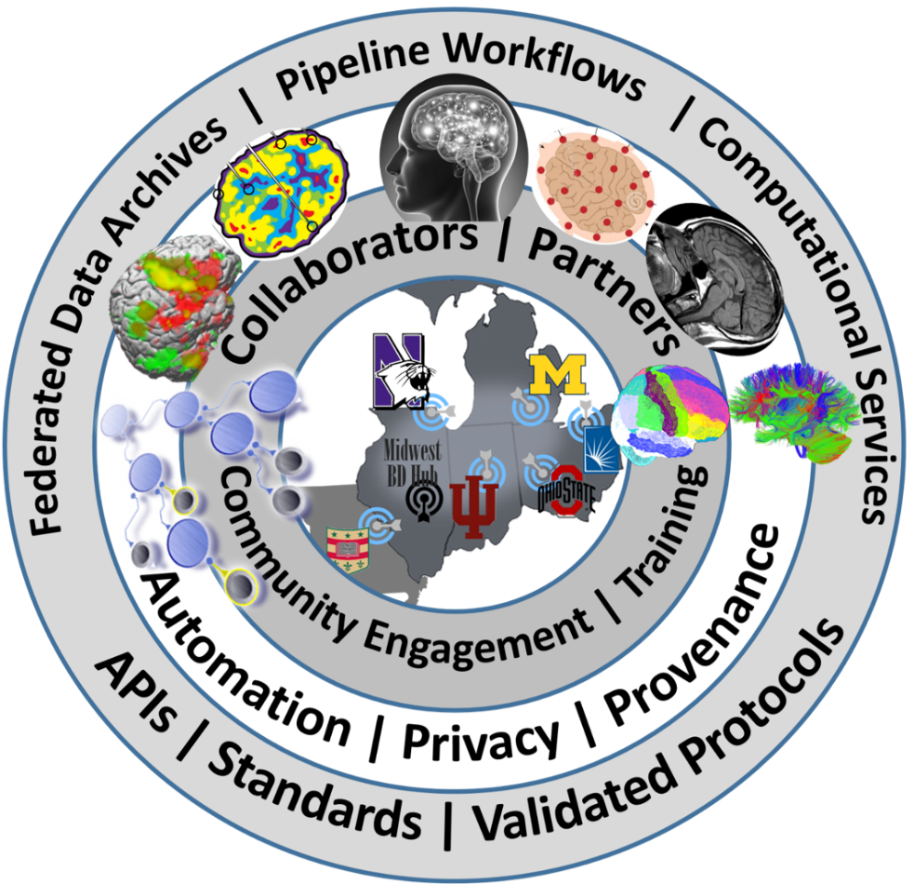

Midwest Workshop on Big Neuroscience Data, Tools, Protocols & Services
Computational Neuroscience Network (ACNN)
http://www.NeuroscienceNetwork.org/ACNN_Workshop_2016.html

Slide 2


Workshop Overview
Ivo D Dinov
Statistics Online Computational Resource (SOCR)
Michigan Institute for Data Science (MIDAS)
University of Michigan
http://www.umich.edu/~dinov

Slide 3
Logistics
WiFi: MGuest
What | An interactive Big Neuroscience Data Analytic Workshop
Where/Venue | Michigan League, University of Michigan, 911 N University Ave, Ann Arbor, MI 48109, Phone: (734) 764-0446, Web: https://uunions.umich.edu/league
Dates | September 20-21, 2016
Accommodation | Michigan League, University of Michigan, 911 N University Ave, Ann Arbor, MI 48109, Phone: (734) 764-0446, Web: https://uunions.umich.edu/league The Holiday Inn Near the University of Michigan, 3600 Plymouth Road, Ann Arbor, MI 48105, 734-796-9800, Web: http://www.hiannarbor.com
Travel Scholarships | 60 Travel scholarships are available for Students, Postdocs, Fellows, and other Trainee on a first-come-first-serve bases
URL | www.NeuroscienceNetwork.org/ACNN_Workshop_2016.html

Slide 4
Program
Time | Day 1 (Tue 9/20/16)
 | Sessions | Details
8-9 AM | Registration | Onsite registration, nametags, booklets, breakfast, coffee, networking
9:00-9:45 | Workshop Overview ACNN Background, Scope Organization/Format | Workshop Overview (Ivo Dinov), 15 min Midwest Big Data Hub Health Sciences (Brian Athey), 15 min Advanced Computational Neuroscience Network (Rich Gonzalez), 15-min
9:45-12:15 | Big Neuroscience Data, Gaps/Barriers, Analytical Methods, Available Resources, Distributed Services, and Opportunities | Indiana Computational Neuroimaging Research (Franco Pestilli) 20 min OSU Network Based Computing (DK Panda, K Hamidouche, X Lu, H Subramoni) 20 min CWRU Biomedical and Healthcare Informatics (Satya Sahoo) 20 min BREAK 10 min (4) HumanConnectome: Neuroimaging Informatics and Analysis Center (Daniel Marcus) 20 min (5) Northwestern Neuroimaging and Applied Computational Anatomy (Lei Wang) 20 min (6) Michigan Institute for Data Science (Ivo Dinov), 20 min
12:15-1:15 | Lunch Break
1:15-3:15 | Unconference Breakouts | Informal self-organized sessions (30-minutes each), round-robin rotations. (4 consecutive slots of 30-min each). Participants lead breakouts and mix with others
3:15-3:30 | Break
3:30-4:30 | Breakout sessions reports | Analytics Pipelines Tools/Services; Challenges; Known Solutions; Predictive analytics - methods, tools, protocols, workflows Provenance (data, protocols, results, reproducibility or research findings); Computational Neuroscience Methods; Case-studies, data archives, Cloud Services
4:30-5:30 | Posters/Demos | Applications (brain mapping, imaging-genetics, neurodegeneration)
6:00-8:00 PM | Dinner | Social Networking

Slide 5
Program
Time | Day 2 (Wed 9/21/16)
 | Sessions | Details
8:00-8:30 AM | Registration | Onsite registration, nametags, booklets, breakfast, coffee, networking
8:30-11:00 | Core Big Neuroscience Infrastructure | Neuroscience Information Framework (NIF): A Cooperative And Collaborative Information, Resource, and Data Discovery Infrastructure (Jeff Grethe) 25 min Indiana Computational Neuroimaging Research (Franco Pestilli) 25 min OSU Network Based Computing (DK Panda, K Hamidouche, X Lu, H Subramoni) 25 min BREAK 10-min (4) CWRU Biomedical and Healthcare Informatics (Satya Sahoo) 25 min (5) Graphical Pipeline Workflows for Integrated Neuroscience (Ivo Dinov), 25 min
11:00-11:10 | Break
11:10-12:10 | Lightning Talks | 3-5 min Rapid-Fire talks from the Midwest Big Data Community
12:10-1:10 | Lunch Break
1:10-2:40 | Unconference Breakouts | Informal self-organized sessions (3 x 30-minutes each), round-robin rotations: Brain structure, Function, Diffusion, Physiology; File Formats; Pipeline workflow Environments; Cloud Services: JIRA, GitHub, Trello, AWS, MapReduce, Hadoop; Driving Biomedical/Healthcare Challenges, etc.
2:40-2:50 | Break
2:50-3:30 | Breakout sessions reports | Analytics Pipelines Tools/Services; Challenges; Known Solutions; Predictive analytics - methods, tools, protocols, workflows; Provenance (data, protocols, results, reproducibility or research findings); Computational Neuroscience Methods; Case-studies, data archives, Cloud Services
3:30-4:00 | Live Demos / Try-It-Now | Applications (brain mapping, imaging-genetics neurodegeneration)
4:00 PM | Conclusions | Workshop Evaluation (http://www.neurosciencenetwork.org/ACNN_Workshop_2016.html). Collaborations, joint papers, extramural grant opportunities, Shareable resources, Available Webapps, APIs, workflows

Slide 6
Handbook

Slide 7
Organizers
The Advanced Computational Neuroscience Network (ACNN)
University of Michigan: Ivo Dinov, Rich Gonzales, George Alter
Indiana University: Franco Pestilli, Olaf Sporns, Andrew Saykin
OSU: DK Panda, Khaled Hamidouche, Xiaoyi Lu, Hari Subramoni
CWRU: Satya Sahoo
Washington University: Daniel Marcus
Northwestern University: Lei Wang

Slide 8
Workshop Goals
Actively engage students, trainees, fellows, junior investigators, and outside researchers in Midwest academic institutions and industry partners
Build an active Midwest Neuroscience Network Community
Openly share data-intense challenges, datasets, research projects, expertise, software, services, protocols, resources, learning modules
Discuss joint (multi-institutional) grants, training opportunities, publications, research projects

Slide 9
Unconference Breakout Sessions
Use the Breakout Session Board/Online-Form to review and propose discussion topics at the appropriate times. Be prepared to take notes at your break out session and report on outcomes, achievements, plans, and actions that came out of the discussions
Unconference Breakout Sessions (consecutive slots of 30-min each). Participants are encouraged to form WGs, lead breakouts, and mix with others. These are Informal self-organized sessions. Participants can rotated through breakouts
https://goo.gl/bKWNvi

Slide 10
Unconference Breakout Sessions
Day 1: 1:00-3:00 PM |  |  |  |  |  | Day 2: 1:00-2:30
Proposed Topics | 1-1:30 | 1:30-2 | 2:2:30 | 2:30-3 |  | Proposed Topics | 1-1:30 | 1:30-2 | 2:2:30
Enter Topic1 | (tally interested attendees) | … | … | … |  | Enter Topic1 | (tally interested attendees) | … | …
… | ... | … | … | … |  | … | ... | … | …
Breakout Session Reports: 3:20-4:20 Analytics Pipelines Tools/Services Challenges Known Solutions Predictive analytics - methods, tools, protocols, workflows Provenance (data, protocols, results, reproducibility or research findings) Computational Neuroscience Methods Case-studies, data archives Cloud Services Other |  |  |  |  |  | Breakout Session Reports: 2:30-3:00 Analytics Pipelines Tools/Services Challenges Known Solutions Predictive analytics - methods, tools, protocols, workflows Provenance (data, protocols, results, reproducibility or research findings) Computational Neuroscience Methods Case-studies, data archives Cloud Services Other
https://goo.gl/bKWNvi

Slide 11
Hands-on & Try-It-Now Demos
Sign in to present and showcase hands-on their group’s challenges, case-studies, datasets, software tools, services, computational infrastructure, and other materials and resources. Avoid sales pitches and infomercials. Open-science resources should be emphasized
Draft a 1-page PDF handout and email to aalison@med.umich.edu
See the Shareable Resources section
Day 2: 3:00-4:00
Demos | 3:00-3:20 | 3:20-3:40 | 3:40-4:00
Demo 1 Description | (tally interested attendees) | … | …
… | ... | … | …
https://goo.gl/bKWNvi

Slide 12
Shareable Resources
Use the web-form to submit items for inclusion in the sharable resources
Examples (not an exclusive list) of appropriate resources include:
Highly scalable APIs
Relevant publications
Cloud-services
Computational Resources
Algorithms, methods, techniques
Education and Training Opportunities
https://goo.gl/gpTrRg

Slide 13

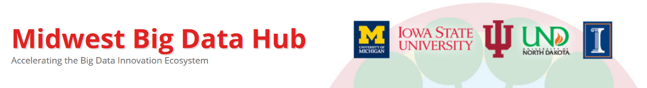






Workshop Sponsors
The National Science Foundation
http://www.nsf.gov
Midwest Big Data Hub
http://MidwestBigDataHub.org
OSU Network Based Computing
http://nowlab.cse.ohio-state.edu
 | High-performance Big Data (HiBD) Network-Based Computing Laboratory
The Michigan Institute for Data Science (MIDAS)
http://midas.umich.edu
The Indiana Imaging Research Facility (IRF)
https://www.indiana.edu/~irf/home
Imaging Research Facility
Indiana University Bloomington
CWRU Biomedical and Healthcare Informatics
https://goo.gl/l19s07
Michigan Nutrition Obesity Research Center
(MNORC) http://mmoc.med.umich.edu

Slide 14
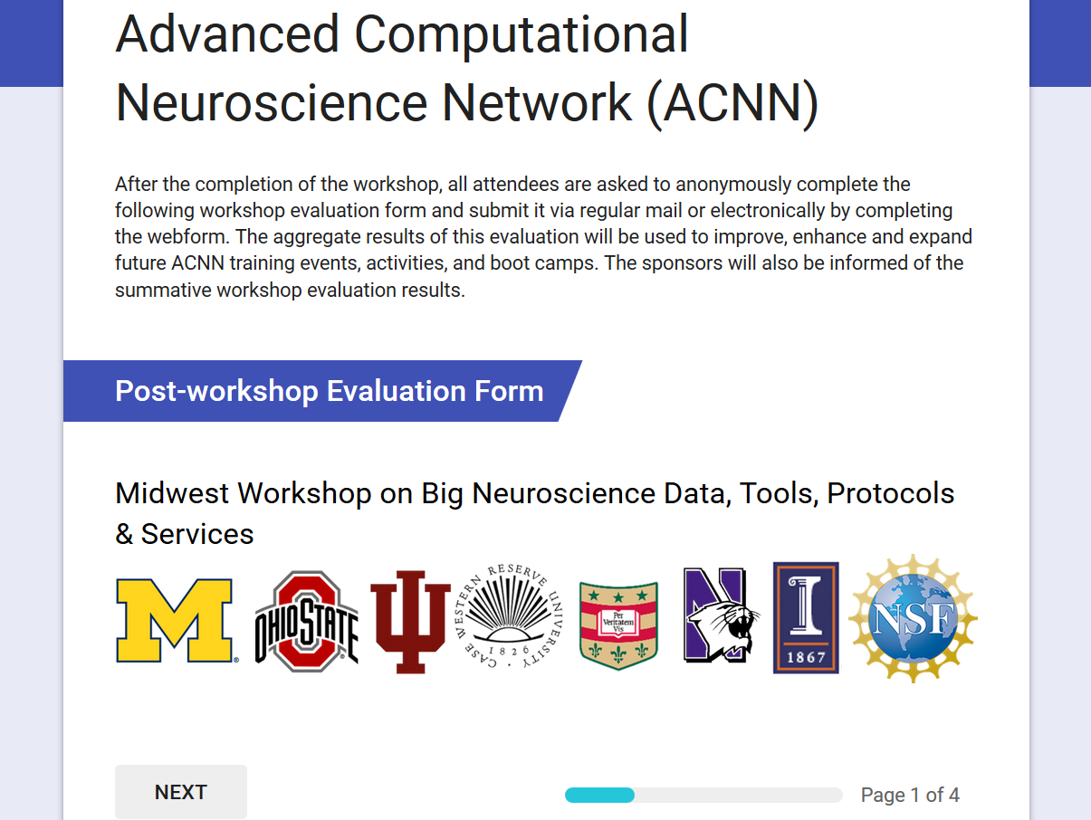
Post-conference Evaluation
After the completion of the workshop, all attendees are asked to anonymously complete the web-based workshop evaluation form. The aggregate results of this evaluation will be used to improve, enhance and expand future ACNN training events, activities and bootcamps. The sponsors will also be informed of the summative workshop evaluation results
http://goo.gl/forms/qSI6PGiN4PfTs6Fg1

Slide 15
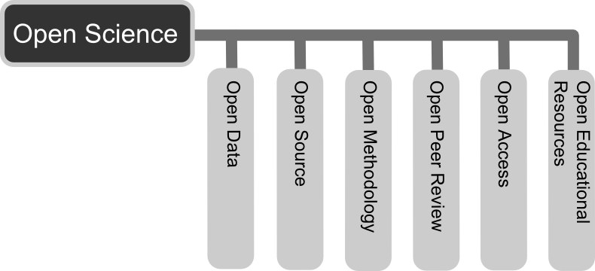
Open-Science Principles
Share resources
Collaborate
Permissive licenses (e.g., LGPL/CC-BY)
Project management (e.g., GitHub/Jira)
Open-access pubs
Public-private partnerships
Co-mentoring of trainees
Effective transdisciplinary methods
Resource Interoperability
Result Reproducibility

Slide 17

Midwest Big Data Hub Health Sciences
Brian Athey
Michigan Institute for Data Science (MIDAS)
University of Michigan
http://www.umich.edu/~bleu

Slide 19

Advanced Computational Neuroscience Network
Rich Gonzalez
Institute for Social Research (ISR)
Michigan Institute for Data Science (MIDAS)
University of Michigan
http://www.umich.edu/~gonzo

Slide 21
Indiana Computational Neuroimaging Research
Franco Pestilli
Indiana University
http://psych.indiana.edu/faculty/franpest.php

Slide 22
Big Neuroscience Data
TBD

Slide 23
Gaps, Barriers & Opportunities
TBD

Slide 24
Analytical Methods
TBD

Slide 25
Available Resources
TBD

Slide 26
Distributed Services
TBD

Slide 28
OSU Network Based Computing
Dhabaleswar Panda
Ohio State University
http://web.cse.ohio-state.edu/~panda

Slide 29
Big Neuroscience Data
TBD

Slide 30
Gaps, Barriers & Opportunities
TBD

Slide 31
Analytical Methods
TBD

Slide 32
Available Resources
TBD

Slide 33
Distributed Services
TBD

Slide 35
CWRU Biomedical and Healthcare Informatics
Satya Sahoo
Case Western Reserve University
https://sites.google.com/a/case.edu/bmhinformaticsgroup/satya-sahoo

Slide 36
Big Neuroscience Data
TBD

Slide 37
Gaps, Barriers & Opportunities
TBD

Slide 38
Analytical Methods
TBD

Slide 39
Available Resources
TBD

Slide 40
Distributed Services
TBD

Slide 42
HumanConnectome: Neuroimaging Informatics and Analysis
Daniel Marcus
Washington University
https://www.mir.wustl.edu

Slide 43
Big Neuroscience Data
TBD

Slide 44
Gaps, Barriers & Opportunities
TBD

Slide 45
Analytical Methods
TBD

Slide 46
Available Resources
TBD

Slide 47
Distributed Services
TBD

Slide 49
Northwestern Neuroimaging and Applied Computational Anatomy
Lei Wang
Northwestern University
http://www.nuin.northwestern.edu/members-2/lwang

Slide 50
Big Neuroscience Data
TBD

Slide 51
Gaps, Barriers & Opportunities
TBD

Slide 52
Analytical Methods
TBD

Slide 53
Available Resources
TBD

Slide 54
Distributed Services
TBD

Slide 55
Michigan Institute for Data Science
Ivo D Dinov
Statistics Online Computational Resource (SOCR)
Michigan Institute for Data Science (MIDAS)
University of Michigan
http://www.umich.edu/~dinov

Slide 56

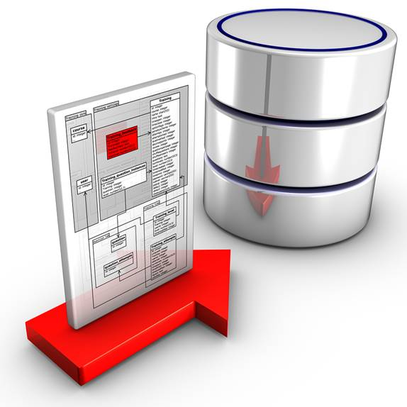
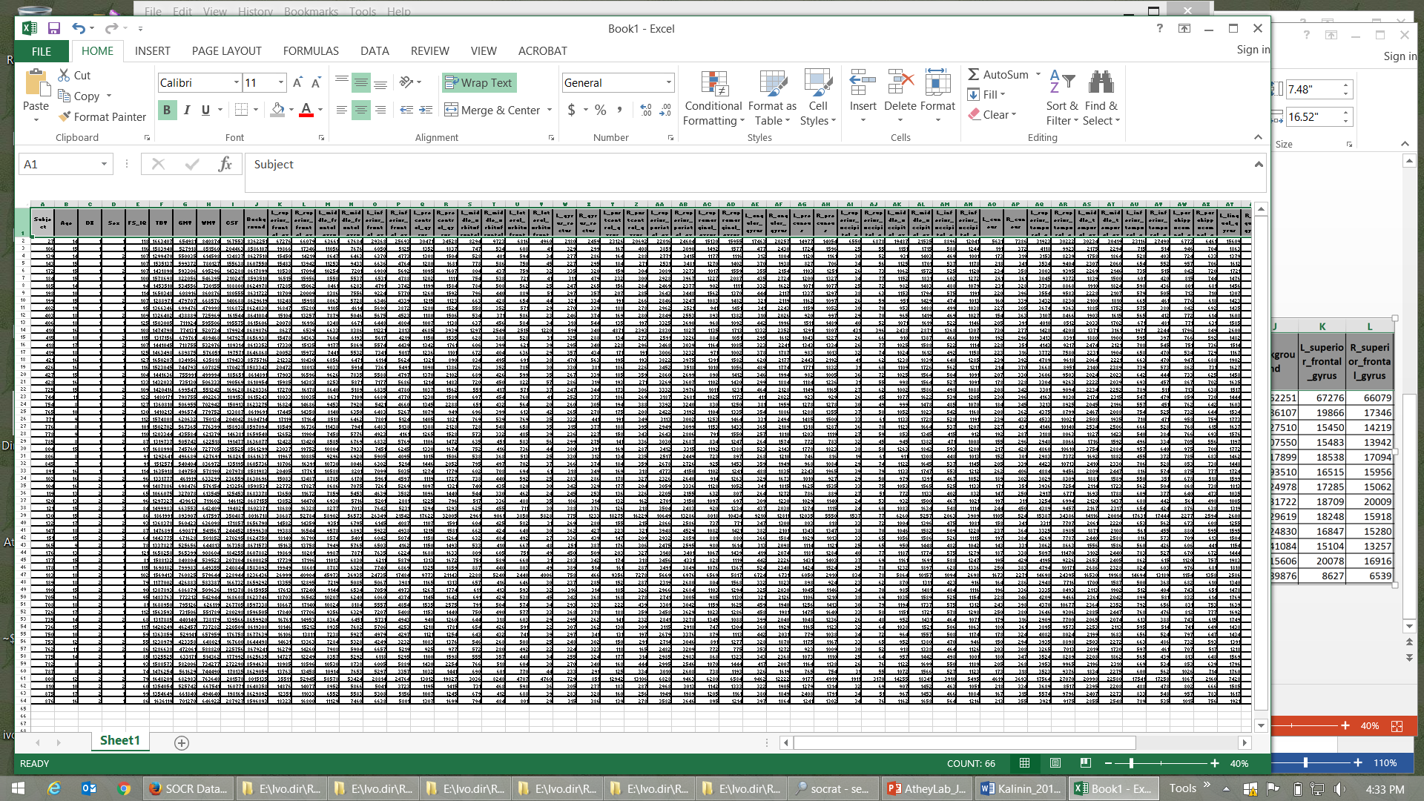

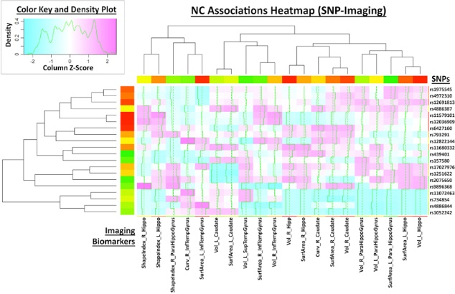
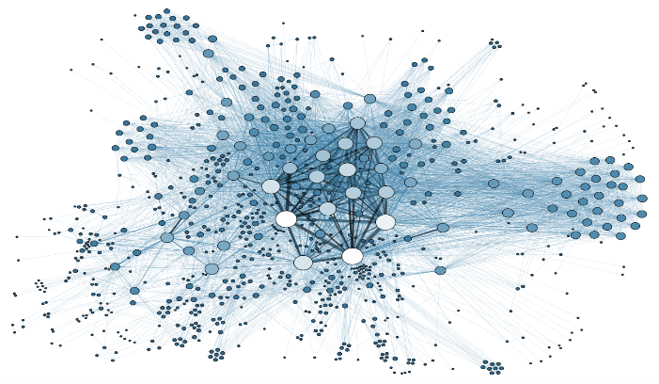
Big Neuroscience Data
TBD
Data
Wrangling
Data
Modeling
Data
Analytics
Data
Visualization

Slide 57
Big Neuroscience Data
Case-Studies | Sample-size | Data Elements | Description
ALS | Longitudinal data for 8K patients (data comes from 2 independent EU registries) | >300 variables including incomplete clinical, physiological, and cognitive data | This case-study needs innovative machine learning methods for automated diagnostic classification (e.g., patients vs. controls) and unsupervised prediction of cognitive and behavioral decline in ALS patients. The multi-source data will be partitioned into training (estimation) and testing (validation) sets. We plan to fit different models and estimate model-free classifiers to either cluster the participants into groups or hierarchies, or to forecast the progression of the disease over time
Depression / SZ | Extremely large longitudinal data (ms samples), 150 subjects | Study design includes 20 (2*2*5) stimuli types, 12 electrode locations, 1,000’s of ms measurements, 4 summary measures | This case-study is focused on identifying a set of P300 biomarkers (using the incomplete high frequency data) that can classify the core cohorts (Bipolar, Schizophrenia, Depression, and healthy controls). We also aim to investigate if P300 responses to emotional stimuli classify the groups better than those to non-emotional stimuli (from standard Go/NoGo tasks). Mean and peak amplitude and latency are candidates based on previously reported results
PD | 550 PPMI subjects with 1-10 observation time points | Demographics, clinical tests, vital signs, MDS-UPDRS scores, ADL, MoCA, sMRI, ESS Sleepiness Scale, GDS-15, genetics | Using heterogeneous data of Parkinson’s Disease (PD), the study aims to develop a comprehensive end-to-end protocol for data characterization, manipulation, processing, cleaning, analysis and validation. Specifically: (1) introduce methods for rebalancing imbalanced cohorts, (2) utilize a wide spectrum of classification methods to generate consistent and powerful phenotypic predictions, and (iii) generate reproducible machine-learning based classification that enables the reporting of model parameters and diagnostic forecasting based on new data
TBI / Trauma | Over 2,000 patients and controls, acute and multiple chronic times | Dozens of structured (imaging, phenotypic, clinical) and unstructured (injury type, notes) data elements | Three major data sets are included: Volumetric in Brain Trauma (VBT), HeadSmat, and PROTECT II. Each of these datasets include patient’s brain CT and/or MRI scans at time of admission, and in some cases during ICU stay, and even during long-term follow up after hospital discharge. These datasets also include time-course data on some physiological measures and blood factors, captured throughout the course of treatment. The UMich/Massey Foundation Grand Challenge provides additional motivation and testing data. The PIs are involved in research funded by this foundation to integrate and analyze these datasets

Slide 58
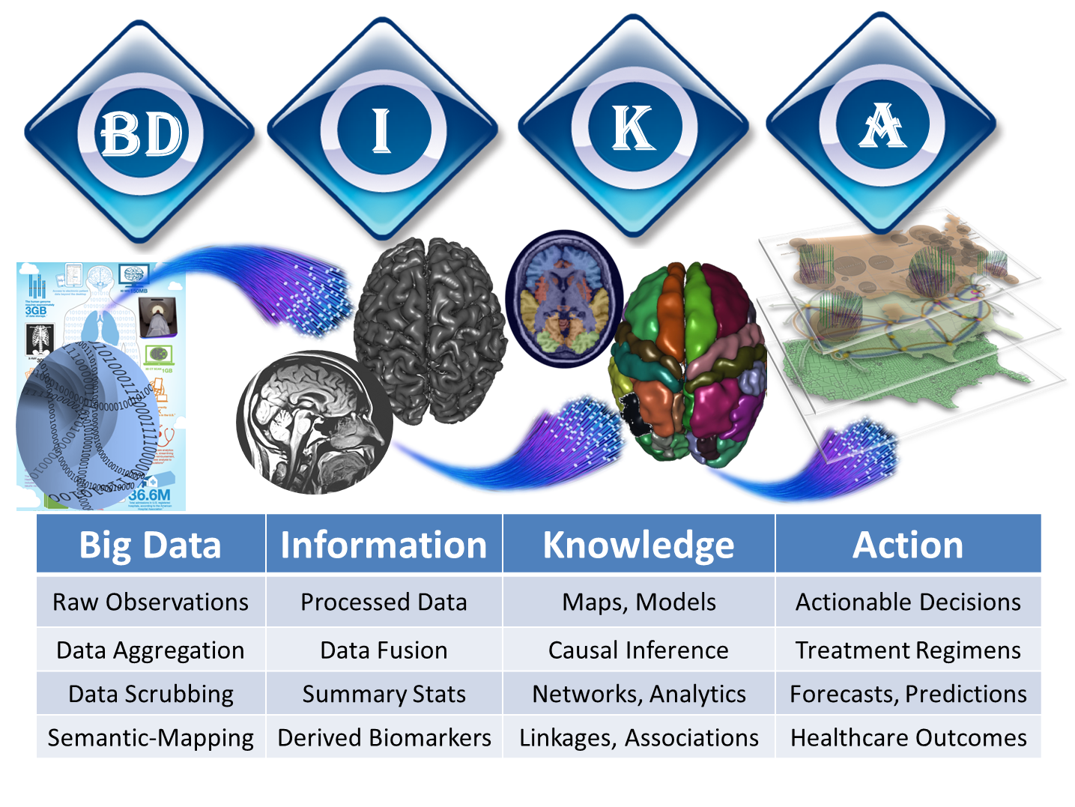
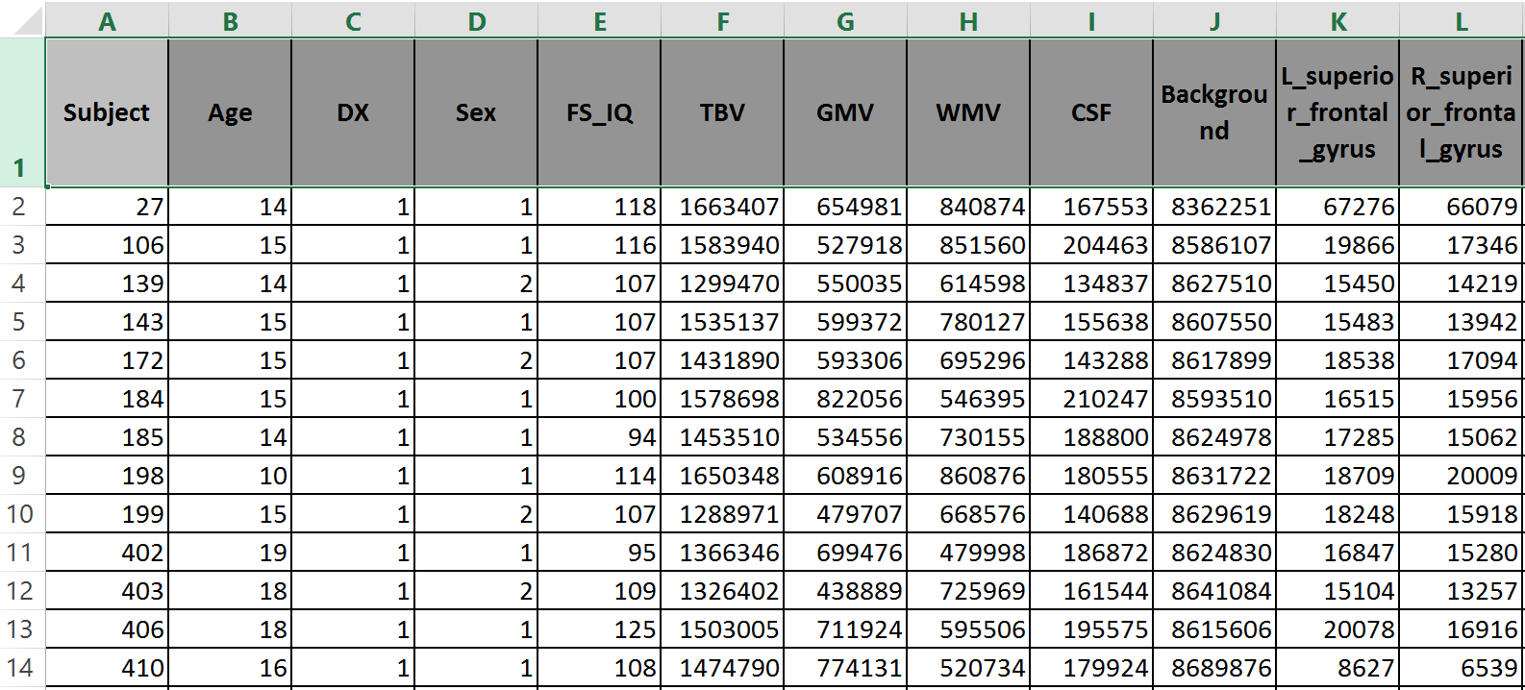

Normal & Schizophrenia
Pediatric Neuroimaging Study

Slide 59
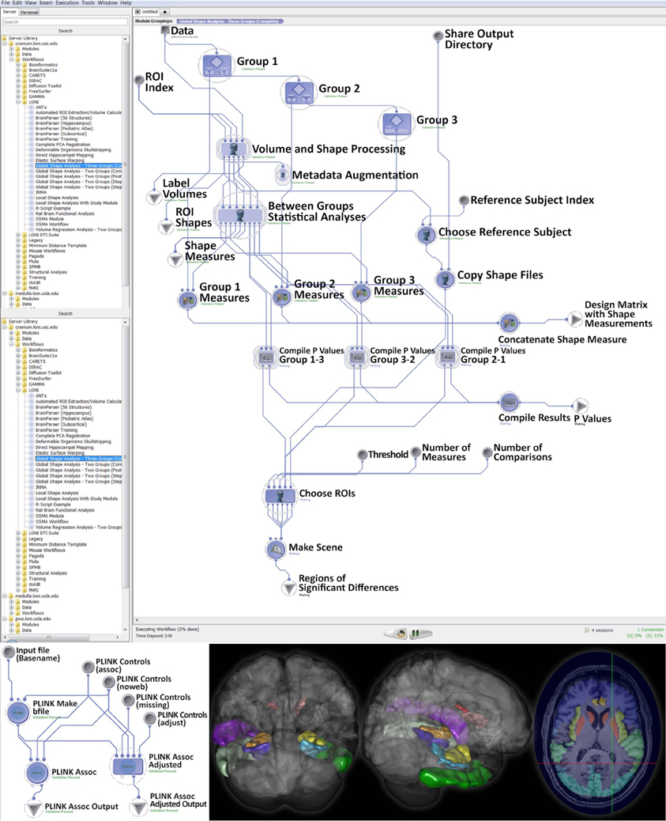
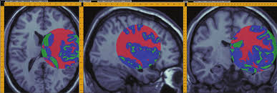
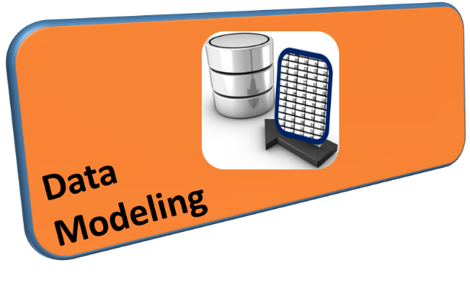

Slide 60
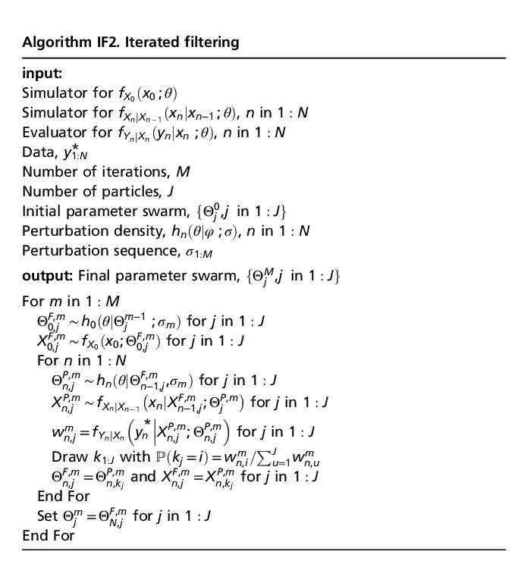
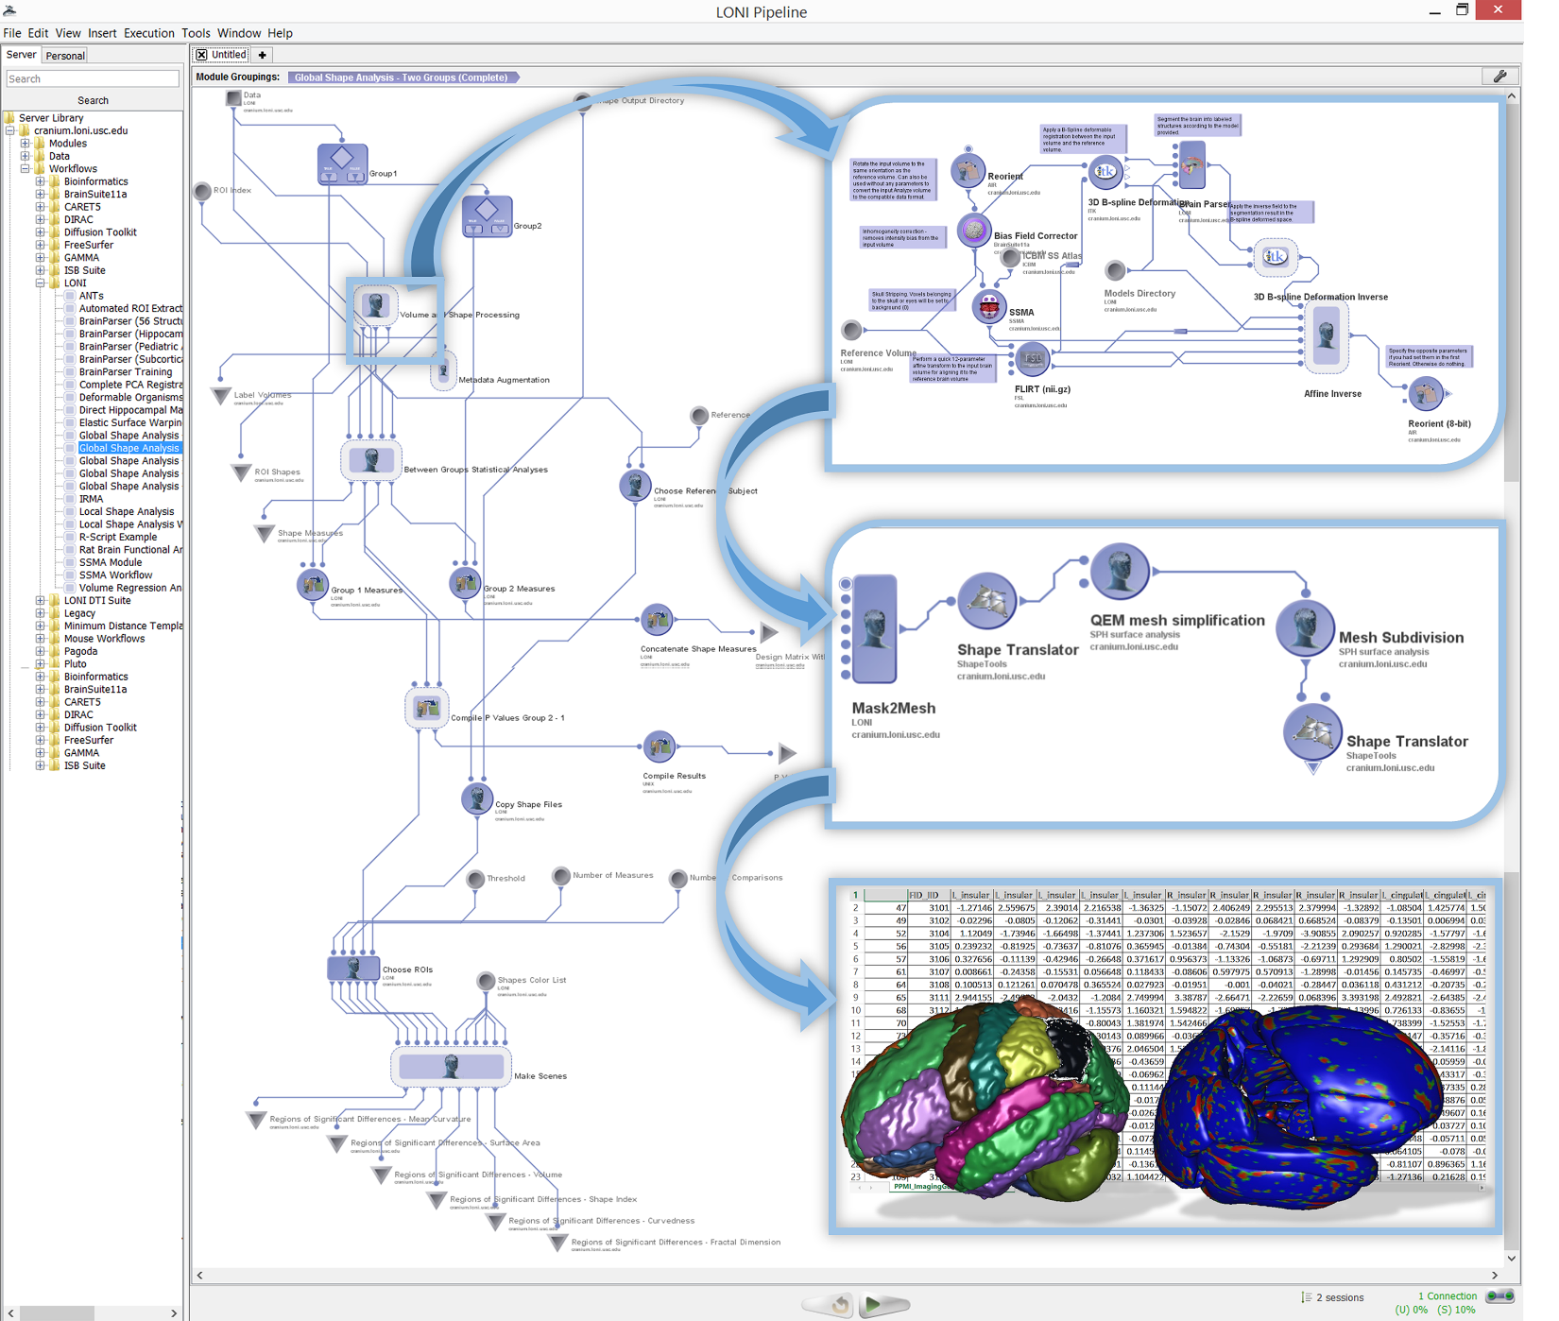
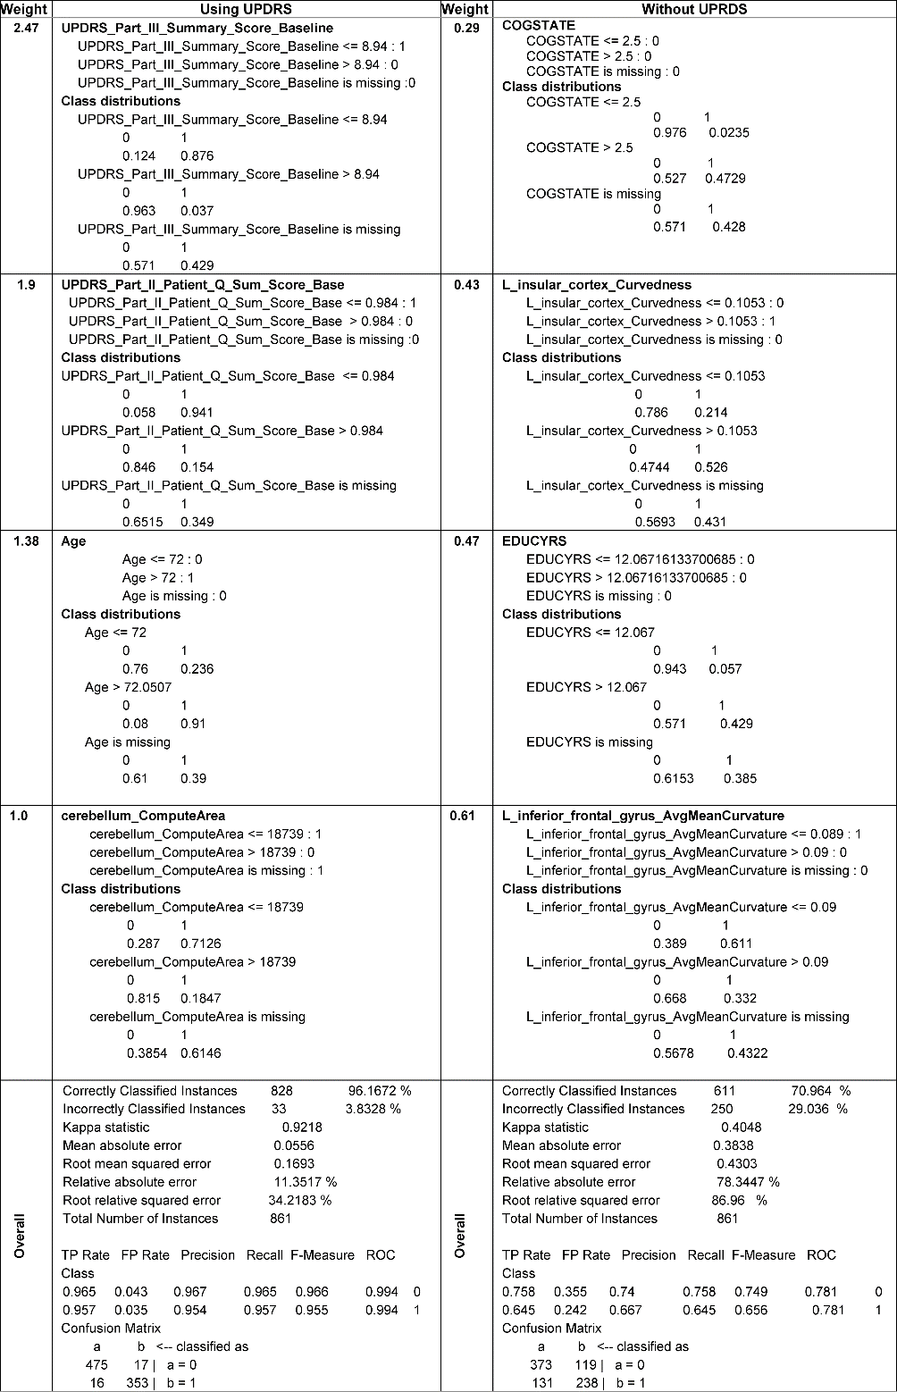
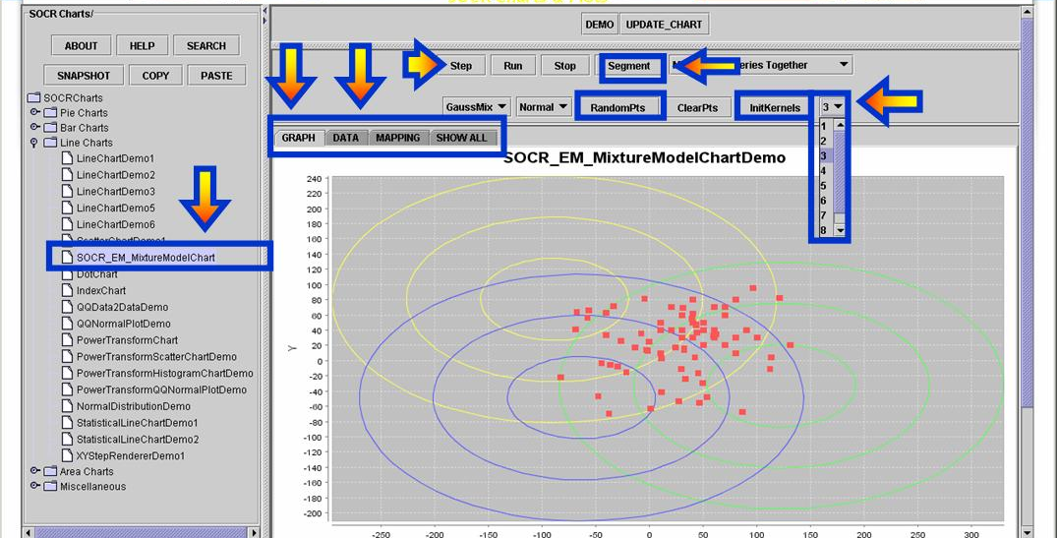
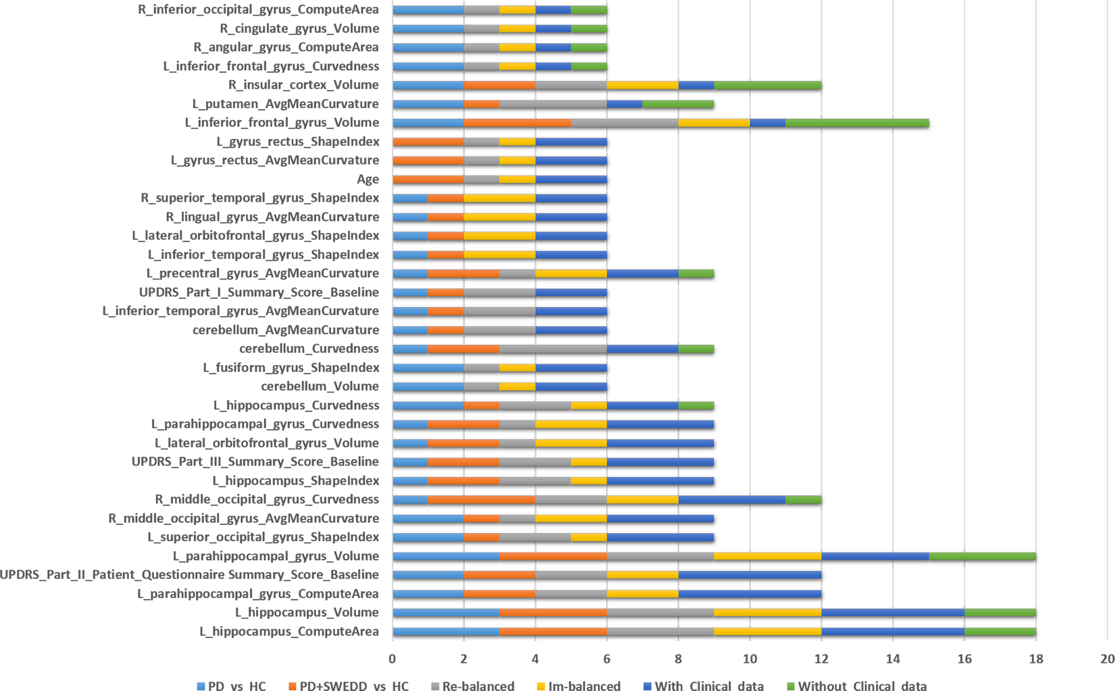
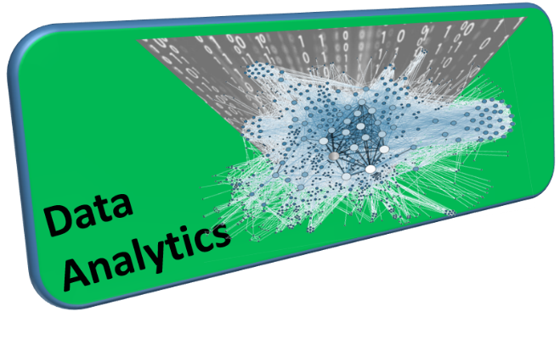
PMID:27494614

Slide 61
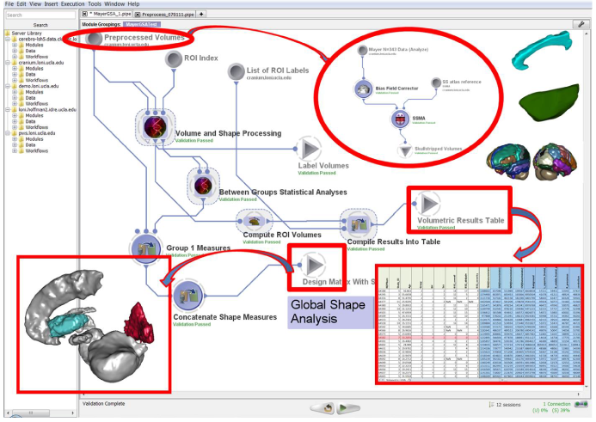
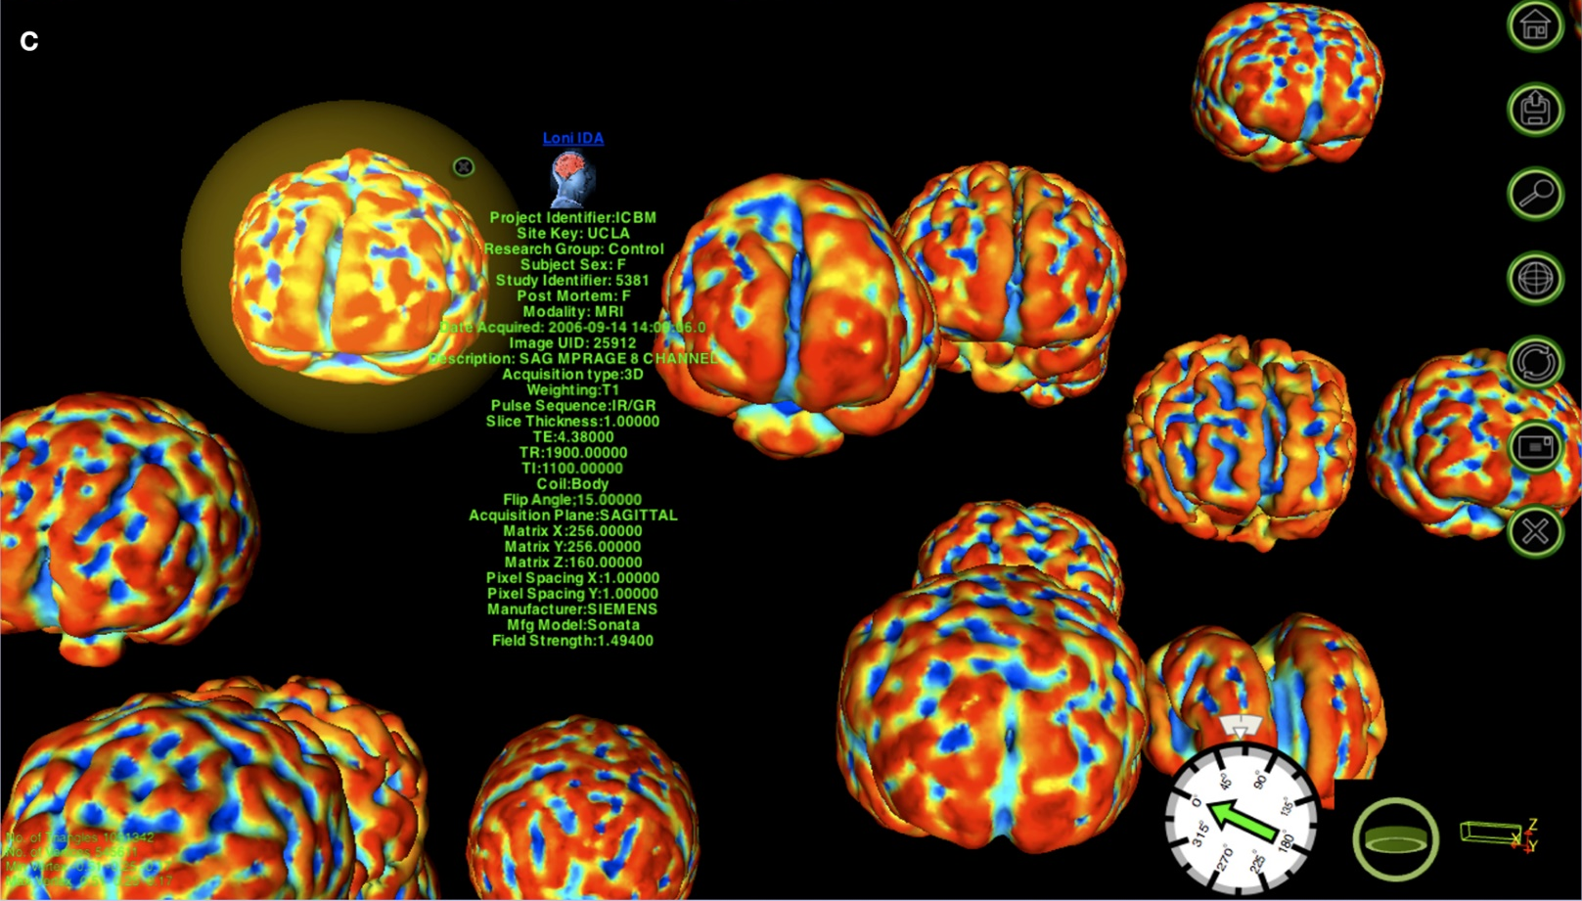
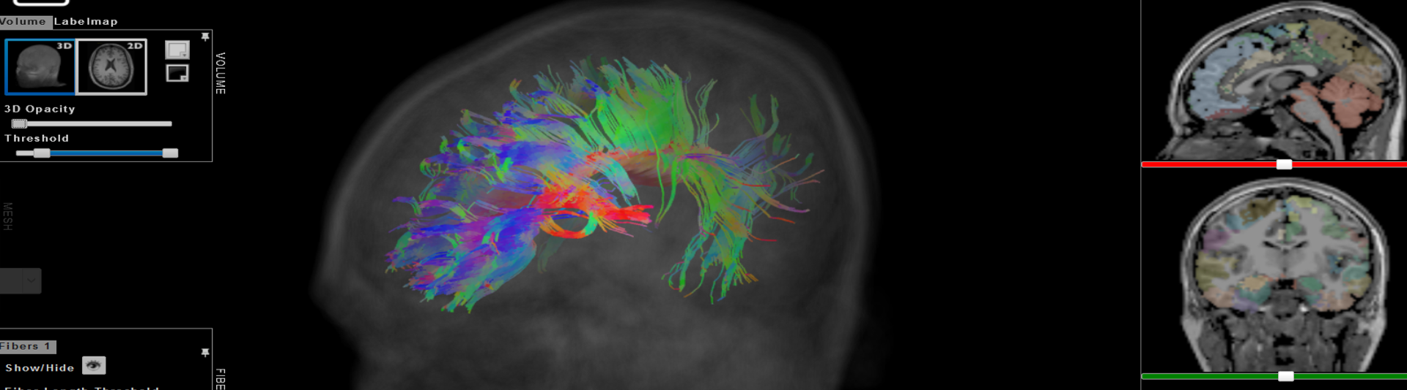
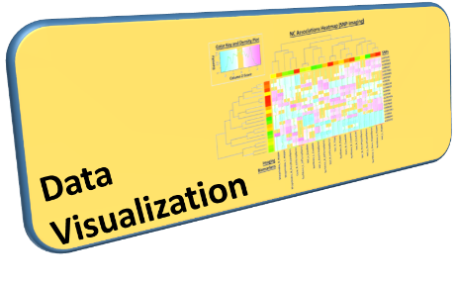

Slide 62
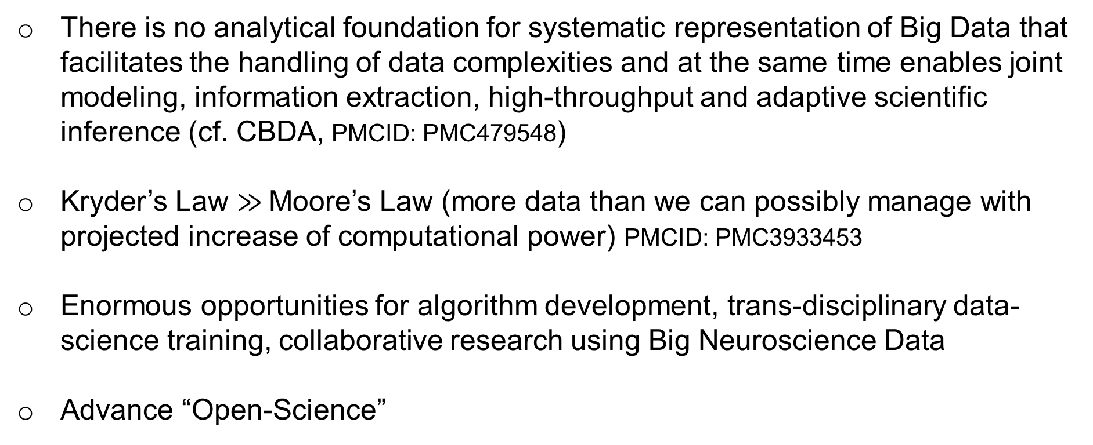
Gaps, Barriers & Opportunities
There is no analytical foundation for systematic representation of Big Data that facilitates the handling of data complexities and at the same time enables joint modeling, information extraction, high-throughput and adaptive scientific inference (cf. CBDA, PMCID: PMC479548)
Kryder’s Law $≫$Moore’s Law (more data than we can possibly manage with projected increase of computational power) PMCID: PMC3933453
Enormous opportunities for algorithm development, trans-disciplinary data-science training, collaborative research using Big Neuroscience Data
Advance “Open-Science”

Slide 63
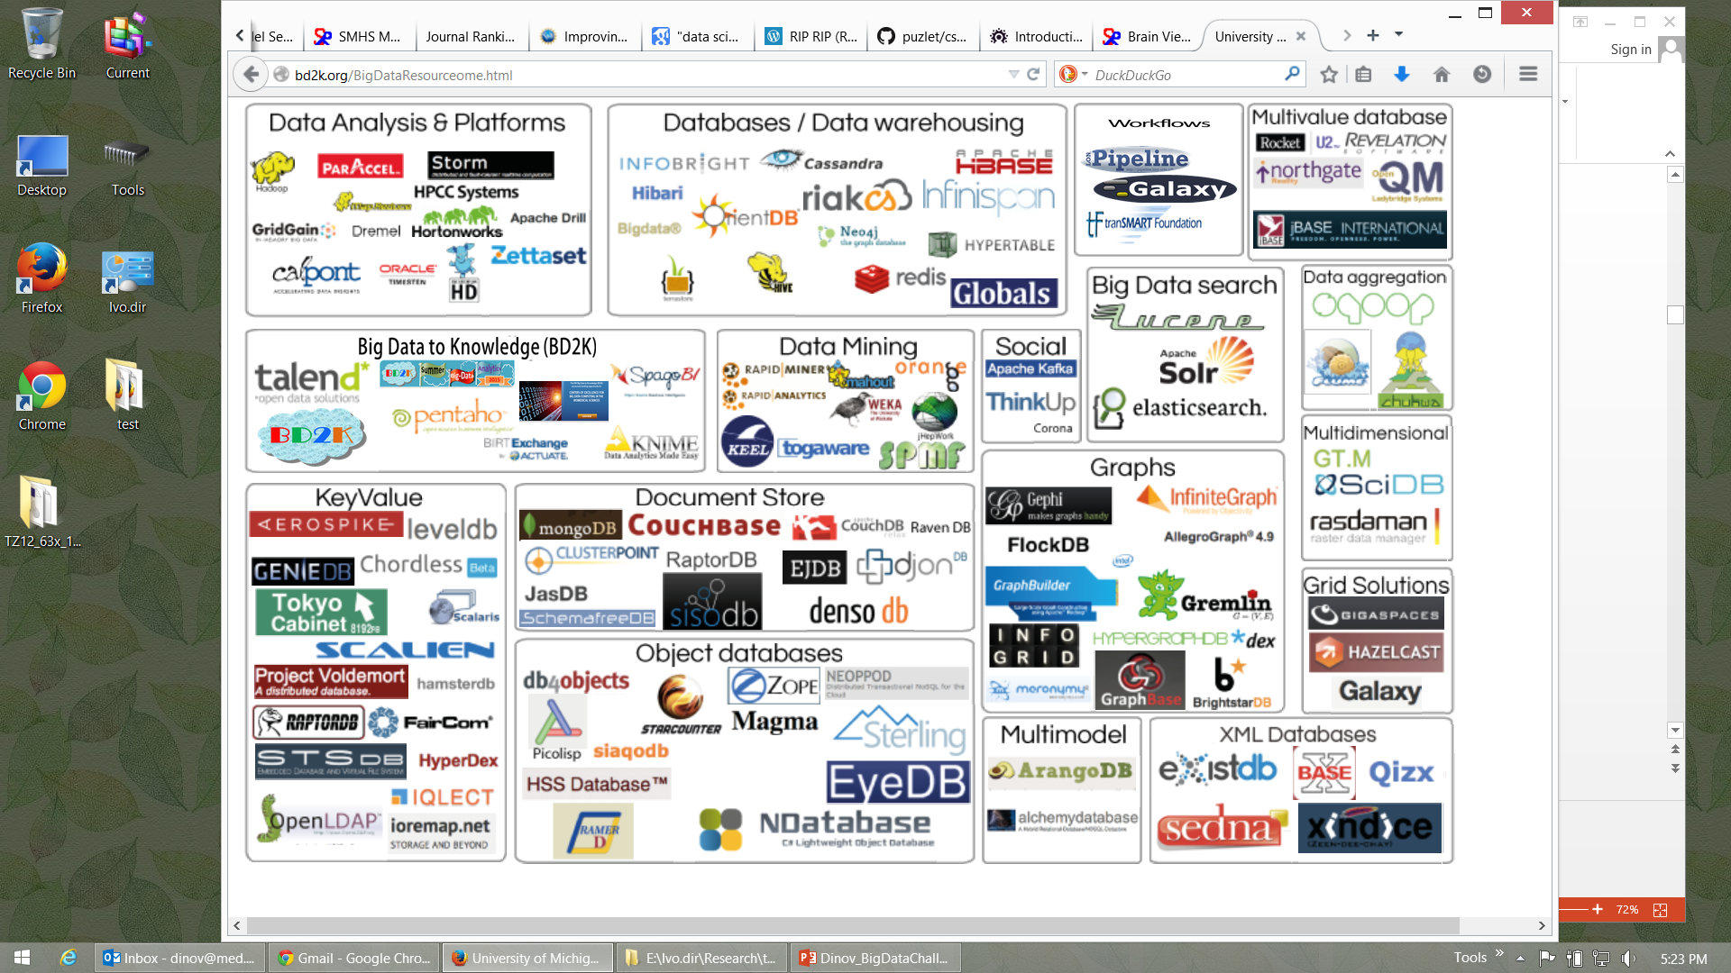




Big Data Analytics Resourceome
http://socr.umich.edu/docs/BD2K/BigDataResourceome.html
Notes:
http://bd2k.org/BigDataResourceome.html

Slide 64
Examples of Available Resources
Source Code: https://github.com/SOCR
End-to-End Pipeline Workflows:
Docs: https://wiki.loni.usc.edu
Protocols: http://pipeline.loni.usc.edu/explore/library-navigator
Pubs: http://www.socr.umich.edu/people/dinov/publications.html
Training/Learning Resources: http://wiki.socr.umich.edu/index.php/SMHS
Data:
Classical: http://wiki.socr.umich.edu/index.php/SOCR_Data
Case-Studies: https://umich.instructure.com/courses/38100/files/folder/Case_Studies

Slide 65
Distributed Services
Processing
Pipeline Try-It-Now Graphical Workflow Environment
(Guest access): http://pipeline.loni.usc.edu/products-services/pws/
socr-pipeline.nursing.umich.edu
AWS/Galaxy: http://GalaxyProject.org
tranSMART: https://github.com/transmart
Data
dbGaP http://dbgap.ncbi.nlm.nih.gov
Neuroimaging http://IDA.loni.usc.edu
XNAT: https://central.xnat.org
Transfer
Globus: http://www.globusonline.org
GridFTP: http://toolkit.globus.org/toolkit/docs/latest-stable/gridftp/

Slide 66
Michigan Institute for Data Science (MIDAS)
MIDAS catalyzes data science at the University of Michigan through support for faculty, research, education and training, and industry engagement
Michigan Institute for Data Science (MIDAS)
Michigan
Data Science
Initiative
Data Science
Services &
Infrastructure
Data Science
Challenge
Initiatives
Consulting for Statistics, Computing & Analytics Research (CSCAR)

Slide 67
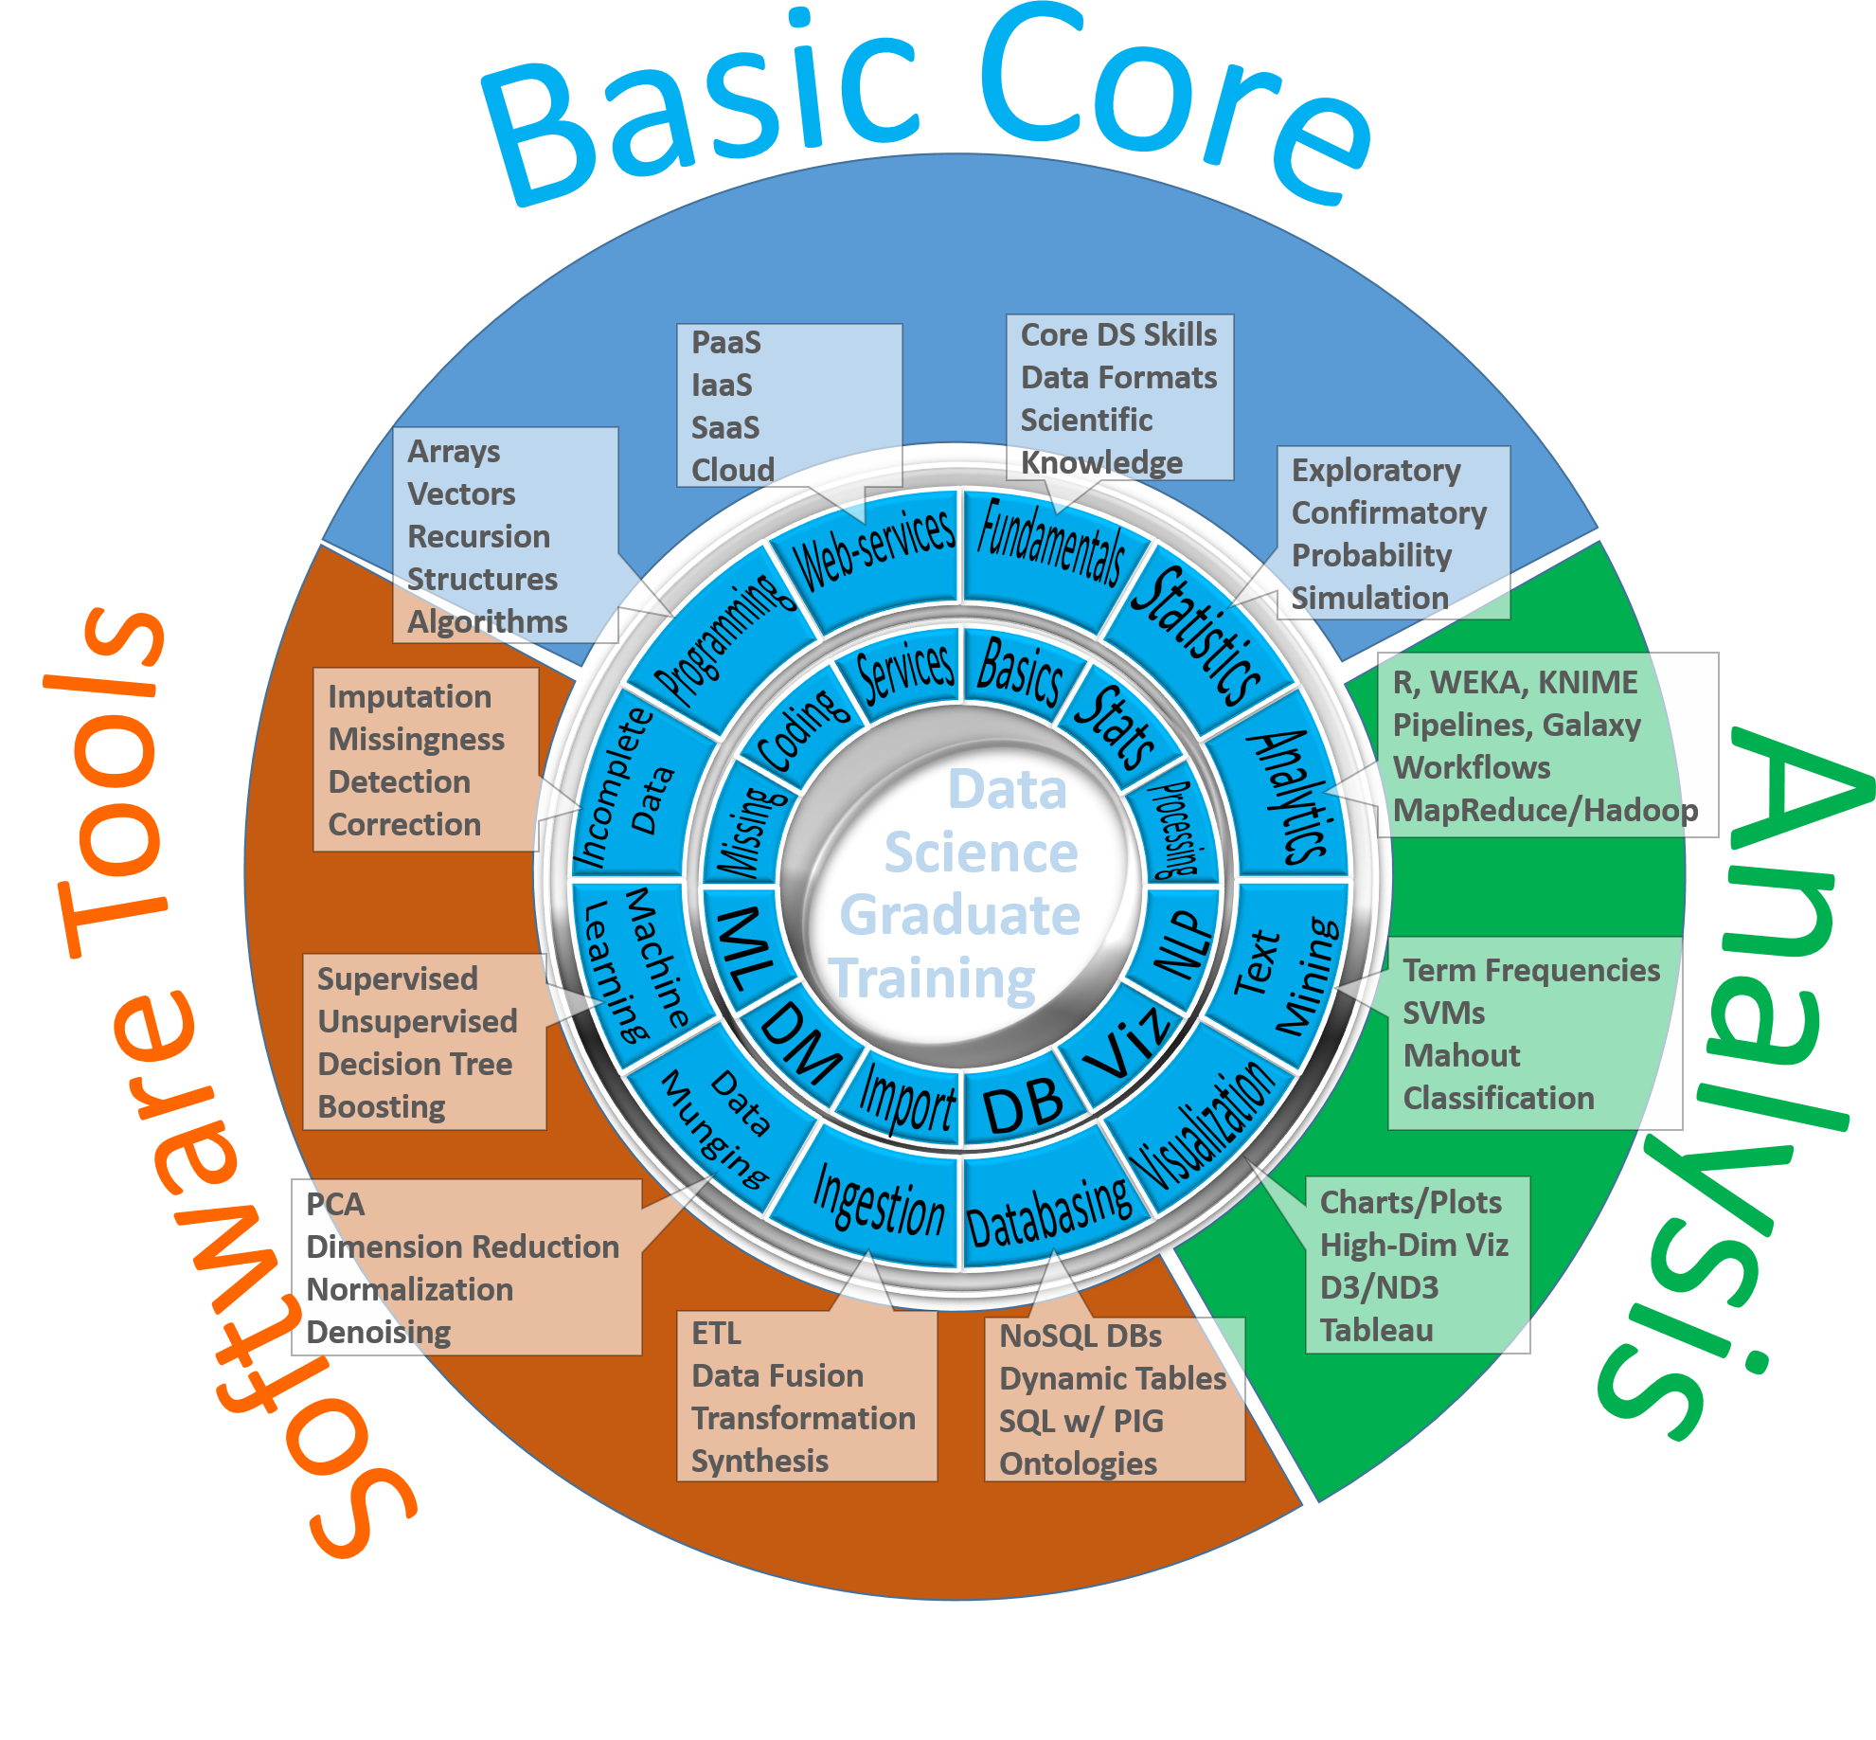
Fundamentals of Data Science Education

Slide 68
Grad DS Curriculum: Prereqs & Competencies
Prerequisites | Skills | Rationale
BS degree or equivalent | Quantitative training and coding skills as described below | The DS certificate is a graduate program requiring a minimum level of quantitative skill
Quantitative training | Undergraduate calculus, linear algebra and intro to probability and statistics | These are the entry level skills required for most upper-level undergrad and grad courses in program
Coding experience | Exposure to software development or programming on the job or in the classroom | Most DS practitioners need substantial experience with Java, C/C++, HTML5, Python, PHP, SQL/DB
Motivation | Significant interest and motivation to pursue quantitative data analytic applications | Dedication for prolonged & sustained immersion into hands-on and methodological research

Slide 69
Grad DS Curriculum: Prereqs & Competencies
Areas | Competency | Expectation | Notes
Algorithms & Applications | Tools | Working knowledge of basic software tools (command-line, GUI based, or web-services) | Familiarity with statistical programming languages, e.g., R or SciKit/Python, and database querying languages, e.g., SQL or NoSQL
 | Algorithms | Knowledge of core principles of scientific computing, applications programming, API’s, algorithm complexity, and data structures | Best practices for scientific and application programming, efficient implementation of matrix linear algebra and graphics, elementary notions of computational complexity, user-friendly interfaces, strings
 | Application Domain | Data analysis experience from at least one application area, either through coursework, internship, research project, etc. | Applied domain examples include: computational social sciences, health sciences, business and marketing, learning sciences, transportation sciences, engineering and physical sciences
Data Management | Data validation & visualization | Curation, Exploratory Data Analysis (EDA) and visualization | Data provenance, validation, visualization via histograms, Q-Q plots, scatterplots (ggplot, Dashboard, D3.js)
 | Data wrangling | Skills for data normalization, data cleaning, data aggregation, and data harmonization/registration | Data imperfections include missing values, inconsistent string formatting (‘2016-01-01’ vs. ‘01/01/2016’, PC/Mac/Lynux time vs. timestamps, structured vs. unstructured data
 | Data infrastructure | Handling databases, web-services, Hadoop, multi-source data | Data structures, SOAP protocols, ontologies, XML, JSON, streaming
Analysis Methods | Statistical inference | Basic understanding of bias and variance, principles of (non)parametric statistical inference, and (linear) modeling | Biological variability vs. technological noise, parametric (likelihood) vs non-parametric (rank order statistics) procedures, point vs. interval estimation, hypothesis testing, regression
 | Study design and diagnostics | Design of experiments, power calculations and sample sizing, strength of evidence, p-values, False Discovery Rates | Multistage testing, variance normalizing transforms, histogram equalization, goodness-of-fit tests, model overfitting, model reduction
 | Machine Learning | Dimensionality reduction, k-nearest neighbors, random forests, AdaBoost, kernelization, SVM, ensemble methods, CNN | Empirical risk minimization. Supervised, semi-supervised, and unsupervised learning. Transfer learning, active learning, reinforcement learning, multiview learning, instance learning

Slide 70
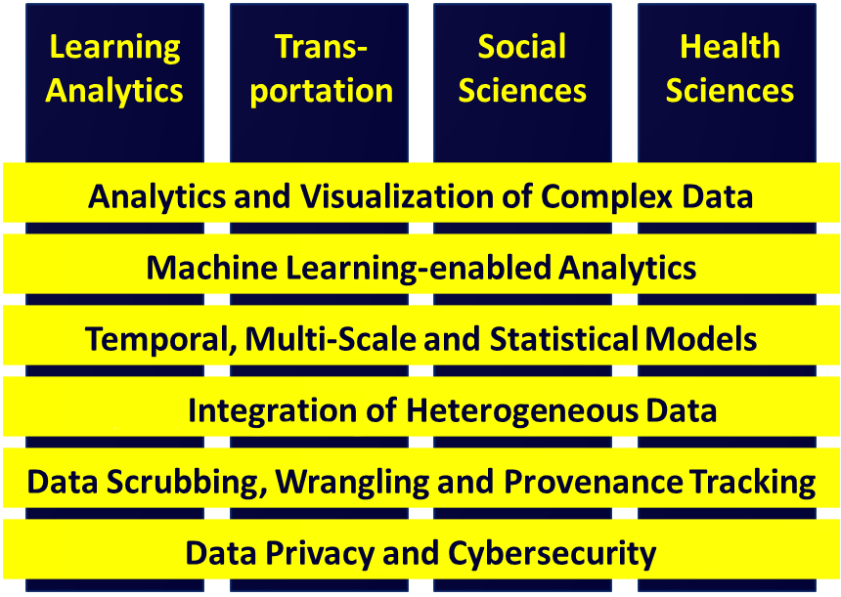
Vertical Integration of MIDAS Challenges and Analytical Methods

Slide 72
12:15-1:15 | Lunch Break
1:15-3:15 | Unconference Breakout Sessions (4 consecutive slots of 30-min each). Participants are encouraged to lead breakouts and mix with others. | Informal self-organized sessions (30-minutes each), round-robin rotations

Slide 74
3:15-3:30 | Break
3:30-4:30 | Breakout sessions reports | Analytics Pipelines Tools/Services
 |  | Challenges
 |  | Known Solutions
 |  | Predictive analytics - methods, tools, protocols, workflows
 |  | Provenance (data, protocols, results, reproducibility or research findings)
 |  | Computational Neuroscience Methods
 |  | Case-studies, data archives, Cloud Services

Slide 76
4:30-5:30 | Posters/Demos | Applications (brain mapping, imaging-genetics neurodegeneration)
6:00-8:00 PM | Dinner | Social Networking

Slide 78
Time | Day 2 (Wed 9/21/16)
 | Sessions | Details
8:00-8:30 | Registration | Onsite registration, nametags, booklets, breakfast, coffee, networking
8:30-11:00 | Core Big Neuroscience Infrastructure | Computational Neuroscience (Jeff Grethe) 25 min Indiana Computational Neuroimaging Research (Franco Pestilli) 25 min OSU Network Based Computing (Dhabaleswar Panda, Khaled Hamidouche, Xiaoyi Lu, Hari Subramoni) 25 min BREAK 10-min CWRU Biomedical and Healthcare Informatics (Satya Sahoo) 25 min (4) Graphical Pipeline Workflows for Integrated Neuroscience (Ivo Dinov), 25 min
11:00-11:10 | Break
11:10-12:10 | Lightning Talks | 3-5 min Rapid-Fire talks from the Midwest Big Data Community
12:10-1:10 | Lunch Break
1:10-2:40 | Unconference Breakout Sessions (3 consecutive slots of 30-min each). Participants are encouraged to lead breakouts and mix with others. | Informal self-organized sessions (30-minutes each), round-robin rotations: Brain structure, Function, Diffusion, Physiology; File Formats; Pipeline workflow Environments; Cloud Services: JIRA, GitHub, Trello, AWS, MapReduce, Hadoop; Driving Biomedical/Healthcare Challenges, etc.
2:40-2:50 | Break
2:50-3:30 | Breakout sessions reports | Analytics Pipelines Tools/Services
 |  | Challenges
 |  | Known Solutions
 |  | Predictive analytics - methods, tools, protocols, workflows
 |  | Provenance (data, protocols, results, reproducibility or research findings)
 |  | Computational Neuroscience Methods
 |  | Case-studies, data archives, Cloud Services
3:30-4:00 | Live Demos Try-It-Now | Applications (brain mapping, imaging-genetics neurodegeneration)
4:00 | Conclusions | Workshop Evaluation (http://www.neurosciencenetwork.org/ACNN_Workshop_2016.html). Collaborations, joint papers, extramural grant opportunities, Shareable resources, Available Webapps, APIs, workflows
 | Post-conference Report | Generate a Report (due 1 month after workshop)

Slide 80
Computational Network Models of the Human Brain
Jeffrey Grethe
UCSD

Slide 81
Big Neuroscience Data
TBD

Slide 82
Gaps, Barriers & Opportunities
TBD

Slide 83
Analytical Methods
TBD

Slide 84
Available Resources
TBD

Slide 85
Distributed Services
TBD

Slide 86
Case-Study
TBD

Slide 88
Ensemble Tractography
Franco Pestilli
Indiana University
http://psych.indiana.edu/faculty/franpest.php

Slide 89
Big Neuroscience Data
TBD

Slide 90
Gaps, Barriers & Opportunities
TBD

Slide 91
Analytical Methods
TBD

Slide 92
Available Resources
TBD

Slide 93
Distributed Services
TBD

Slide 94
Case-Study
TBD

Slide 96
BigDataBench & InfiniBand Network Analysis
DK Panda
Ohio State University
http://web.cse.ohio-state.edu/~panda

Slide 97
Big Neuroscience Data
TBD

Slide 98
Gaps, Barriers & Opportunities
TBD

Slide 99
Analytical Methods
TBD

Slide 100
Available Resources
TBD

Slide 101
Distributed Services
TBD

Slide 102
Case-Study
TBD

Slide 104
CWRU Biomedical and Healthcare Informatics
Satya Sahoo
Case Western Reserve University
https://sites.google.com/a/case.edu/bmhinformaticsgroup/satya-sahoo

Slide 105
Big Neuroscience Data
TBD

Slide 106
Gaps, Barriers & Opportunities
TBD

Slide 107
Analytical Methods
TBD

Slide 108
Available Resources
TBD

Slide 109
Distributed Services
TBD

Slide 110
Case-Study
TBD

Slide 112
Predictive Big Data Analytics
Ivo D Dinov
Statistics Online Computational Resource (SOCR)
Michigan Institute for Data Science (MIDAS)
University of Michigan
http://www.umich.edu/~dinov

Slide 113
Characteristics of Big Biomed Data
IBM Big Data 4V’s: Volume, Variety, Velocity & Veracity
BD Dimensions | Tools
Size | Harvesting and management of vast amounts of data
Complexity | Wranglers for dealing with heterogeneous data
Incongruency | Tools for data harmonization and aggregation
Multi-source | Transfer and joint modeling of disparate elements
Multi-scale | Macro to meso to micro scale observations
Incomplete | Reliable management of missing data
Example: analyzing observational data of 1,000’s Parkinson’s disease patients based on 10,000’s signature biomarkers derived from multi-source imaging, genetics, clinical, physiologic, phenomics and demographic data elements.
Software developments, student training, service platforms and methodological advances associated with the Big Data Discovery Science all present existing opportunities for learners, educators, researchers, practitioners and policy makers
Dinov, et al. (2014)
Notes:
What is Big Data? Big data is very different from traditional (small) data due to the exotic challenges it presents and because of its potential to revolutionize our understanding of the world around us. There are 6 characteristics that make Big Data unique. These 6-dimensions (6Ds) of Big Data are defined by its unique attributes: (1) Size – the volume of data exceeds standard storage, memory and computational capabilities, (2) Incongruency – samples, cases and observations in the data may be highly non-homologous, which requires special treatment during the data analytics phase, (3) Incompleteness – Big Data may be sparse with (random and non-random causes of) missing values due to the en masse nature of generation and collection of data elements, (4) Complexity – as the dimension of the data increases distance metrics between observations become degenerate (curse of dimensionality) leading to considerable computational and interpretation challenges, (5) Multi-scale – Big Data frequently includes observations from micro to meso to macro levels, across time, space and frequency spectra, and (6) Multi-source – numerous digital, analogous and mixed data is produced by devices and instruments demand integration (fusion) of relevant data within and beyond the scope of any specific research study. These 6Ds allow us to begin the processes of model, algorithm and tool development necessary to cope with the specific challenges that make “standard scientific methods” impractical for Big Data. Big Data science is team-based and highly trans-disciplinary. It requires diverse, broad, and complementary expertise, specialized training, continuous development efforts, high-throughput analytics, and powerful techniques for data interrogation. The scope of Big Data challenges are illustrated by the problem of analyzing observational data of 1,000’s Parkinson’s disease patients based on 10,000’s signature biomarkers derived from multi-source imaging, genetics, clinical, physiologic, phenomics and demographic data elements. Similar data-driven exploratory and confirmatory analytic examples can be demonstrated in other disciplines. Software developments, student training, service platforms and methodological advances associated with the Big Data Discovery Science all present existing opportunities for learners, educators, researchers, practitioners and policy makers
http://www.onlinecharttool.com/graph?selected_graph=radar

Slide 114

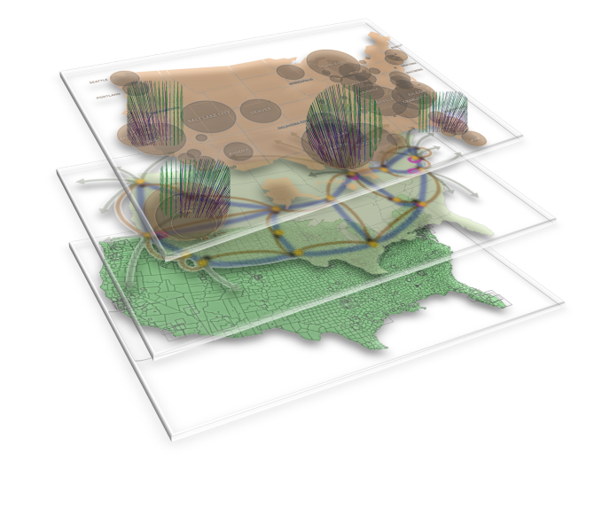

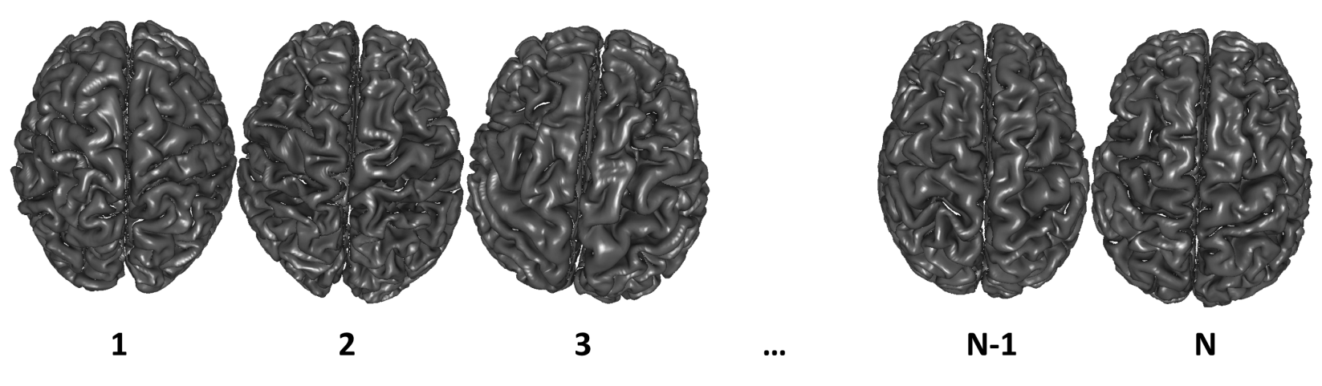
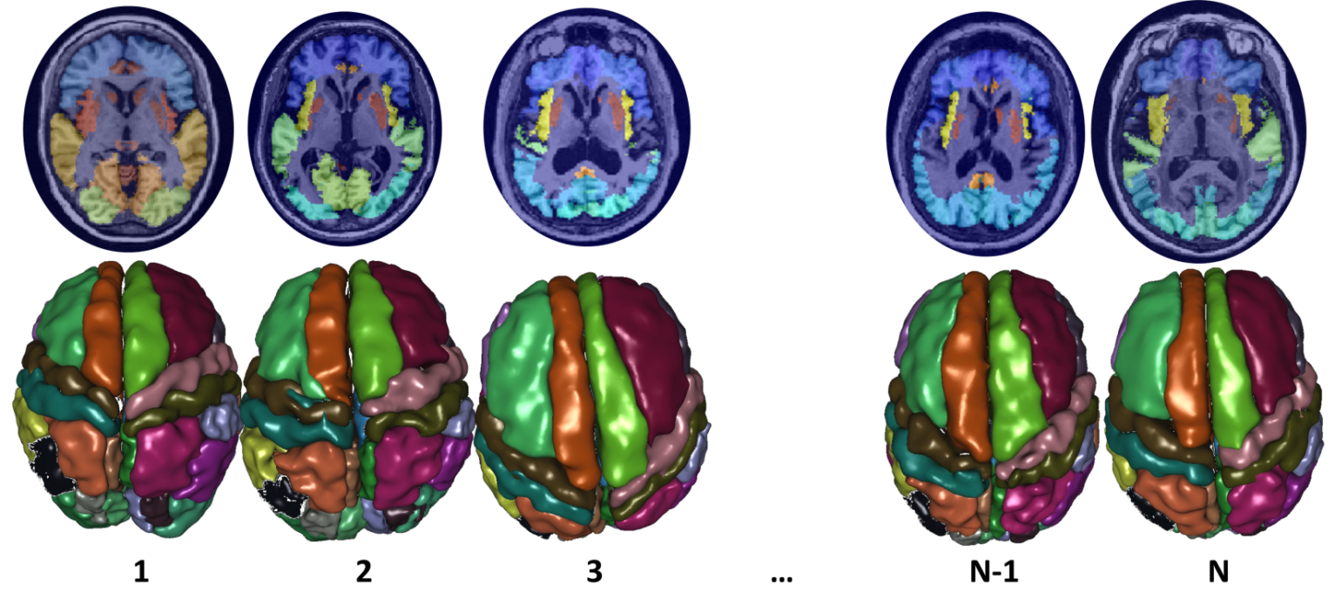
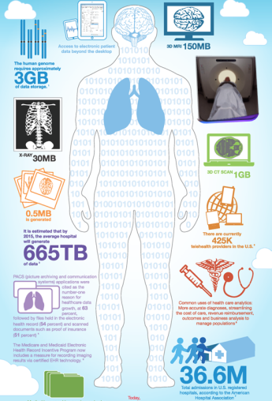



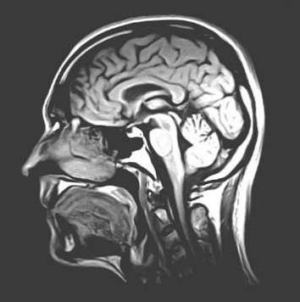

BD
I
K
A
Big Data | Information | Knowledge | Action
Raw Observations | Processed Data | Maps, Models | Actionable Decisions
Data Aggregation | Data Fusion | Causal Inference | Treatment Regimens
Data Scrubbing | Summary Stats | Networks, Analytics | Forecasts, Predictions
Semantic-Mapping | Derived Biomarkers | Linkages, Associations | Healthcare Outcomes
Dinov, GigaScience, 2016
Notes:
Neurodegenerative diseases provide an excellent example of a driving Big Data Analytic biomedical Challenge

Slide 115
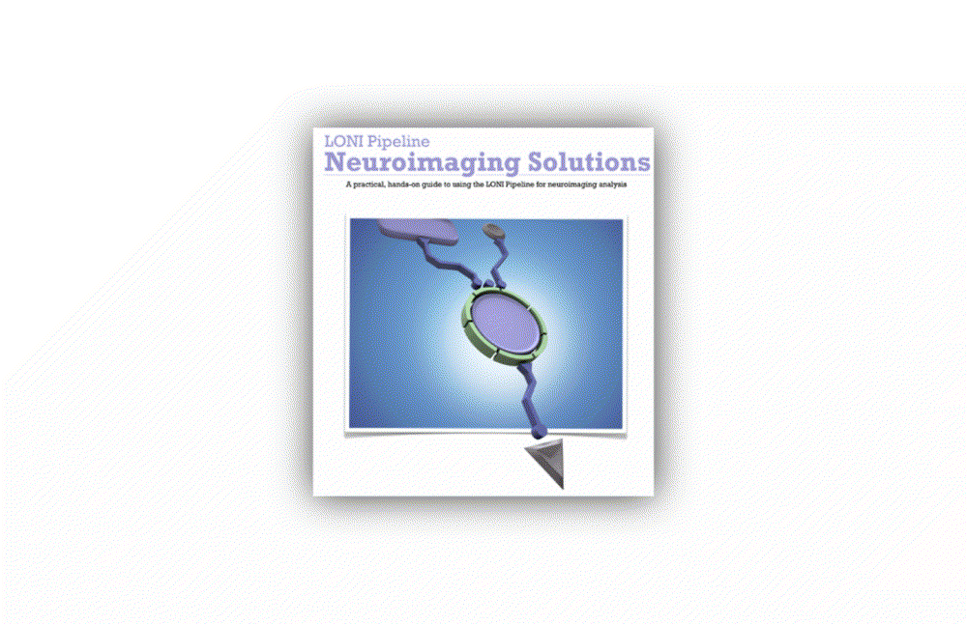
End-to-end Pipeline Workflow Solutions
Dinov, et al., 2014, Front. Neuroinform.; Dinov, et al., Brain Imaging & Behavior, 2013
Notes:
Big Data has intrinsically multi-dimensional characteristics …

Slide 116
Predictive Big Data Analytics in Parkinson’s Disease
A unique archive of Big Data: Parkinson’s Progression Markers Initiative (PPMI). Defining data characteristics – large size, incongruency, incompleteness, complexity, multiplicity of scales, and heterogeneity of information-generating sources (imaging, genetics, clinical, demographic)
Approach
introduce methods for rebalancing imbalanced cohorts,
utilize a wide spectrum of classification methods to generate phenotypic predictions,
reproducible machine-learning based classification
Results of machine-learning based classification show significant power to predict Parkinson’s disease in the PPMI subjects (consistent accuracy, sensitivity, and specificity exceeding 96%, confirmed using internal statistical 5-fold cross-validation). Clinical (e.g., Unified Parkinson's Disease Rating Scale (UPDRS) scores), demographic (e.g., age), genetics (e.g., rs34637584, chr12), and derived neuroimaging biomarker (e.g., cerebellum shape index) data all contributed to the predictive analytics and diagnostic forecasting.
Model-free Big Data machine learning-based classification methods (e.g., adaptive boosting, support vector machines) outperform model-based techniques (GEE, GLM, MEM) in terms of predictive precision and reliability (e.g., forecasting patient diagnosis). UPDRS scores play a critical role in predicting diagnosis, which is expected based on the clinical definition of Parkinson’s disease. Even without longitudinal UPDRS data, however, the accuracy of model-free machine learning based classification is over 80%. The methods, software and protocols developed here are openly shared and can be employed to study other neurodegenerative disorders (e.g., Alzheimer’s, Huntington’s).
Dinov, et al., PLoS, 2016
Notes:
Imputation: In our experiments, we used the R-packages MICE (MI via chained equations) and MI to perform $m=5$ chained imputations.
Imbalanced Sample-Sizes: The R package SMOTE (Synthetic Minority Over-sampling TEchnique) facilitated the group rebalancing of the native imbalanced cohorts by creating synthetic instances of the under sampled class (e.g., controls).
Stratification: Most of our cohort comparisons were done on stratified data – by cohort-definition (HC vs PDs, or HC vs. Patients (PDs + SWEDDs)) and by cohort-size (raw unbalanced comparisons, or comparisons of SMOTE-rebalanced group sizes).

Slide 117
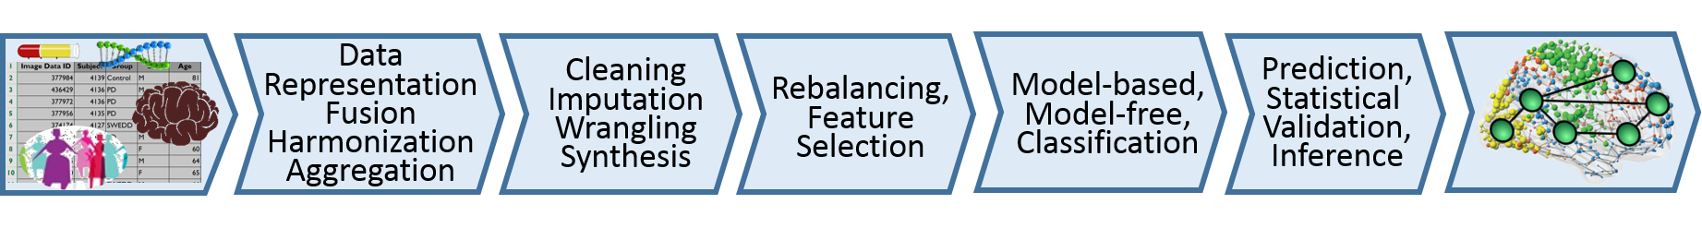
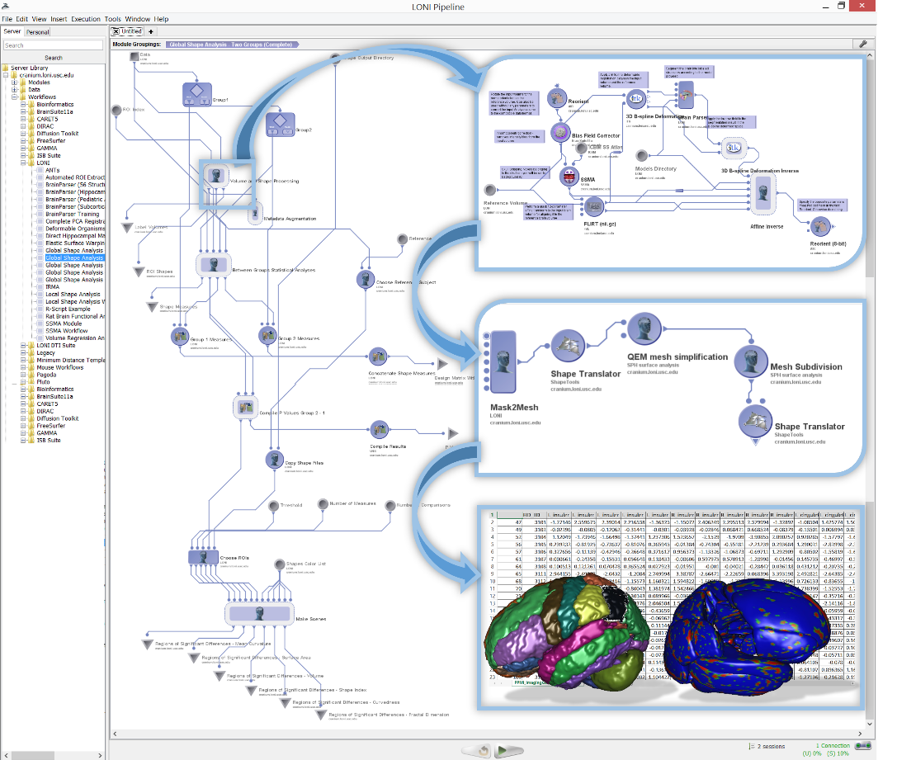
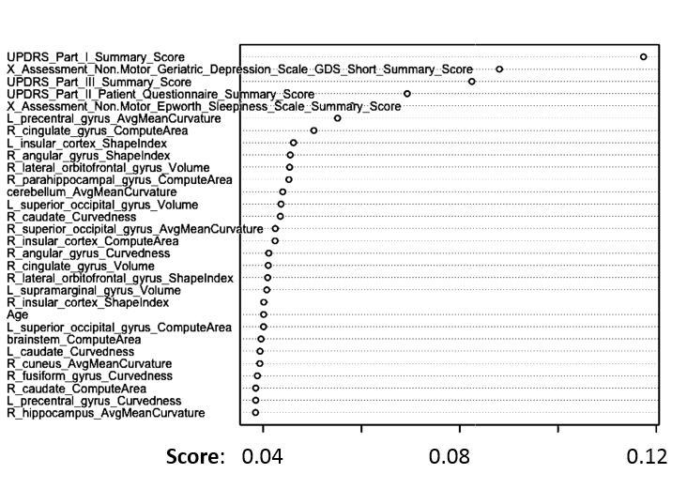
Predictive Big Data Analytics: Applications to Parkinson’s Disease
Varplot illustrating:
the critical predictive data elements (Y-axis)
and their impact scores (X-axis)
AdaBoost classifier for Controls vs. Patients prediction
ML classifier | accuracy | sensitivity | specificity | positive predictive value | negative predictive value | log odds ratio (LOR)
AdaBoost | 0.996324 | 0.994141 | 0.998264 | 0.9980392 | 0.9948097 | 11.4882058
SVM | 0.985294 | 0.994140 | 0.977431 | 0.9750958 | 0.9946996 | 8.902166
Dinov, et al., PLoS, 2016

Slide 118
Predictive Big Data Analytics: Applications to Parkinson’s Disease
Best Machine Learning Based Classification Results (according to average measures of 5-fold cross-validation)
Data Strata | Classifier | FP | TP | TN | FN | Accu-racy | Sensi-tivity | Speci-ficity | positive predictive value | negative predictive value | log odds ratio (LOR)
balanced control/PD | ada | 0.2 | 102 | 115 | 0.6 | 0.99632 | 0.99414 | 0.99826 | 0.998039 | 0.9948097 | 11.4882
balanced control/PD | svm | 2.6 | 102 | 113 | 0.6 | 0.98529 | 0.99414 | 0.97743 | 0.975096 | 0.9946996 | 8.902166
balanced control/PD&SWEDD | svm | 3.4 | 101 | 112 | 1 | 0.97978 | 0.99023 | 0.97049 | 0.967557 | 0.9911348 | 8.1120092
balanced control/PD&SWEDD | ada | 1.4 | 101 | 114 | 1.8 | 0.98529 | 0.98242 | 0.98785 | 0.986275 | 0.9844291 | 8.4214
unbalanced control/PD | ada | 0.2 | 25 | 54 | 0.8 | 0.98753 | 0.96875 | 0.99634 | 0.992 | 0.9855072 | 9.039789
unbalanced control/PD&SWEDD | ada | 1.2 | 24 | 61 | 1.8 | 0.96599 | 0.92969 | 0.98083 | 0.952 | 0.971519 | 6.516987
Dinov, et al., PLoS, 2016

Slide 119
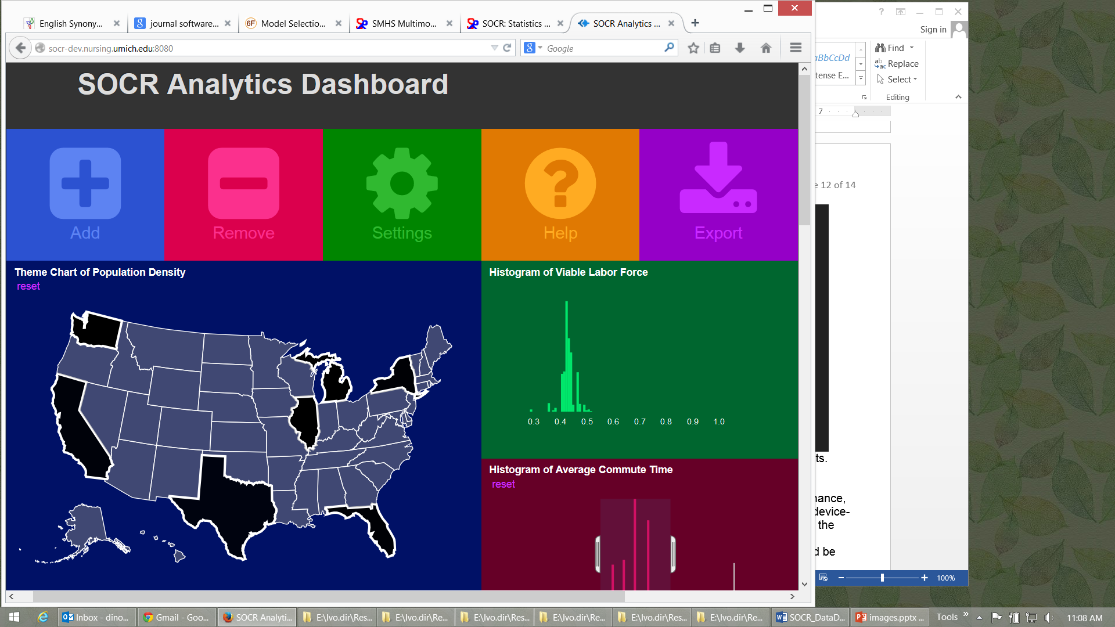
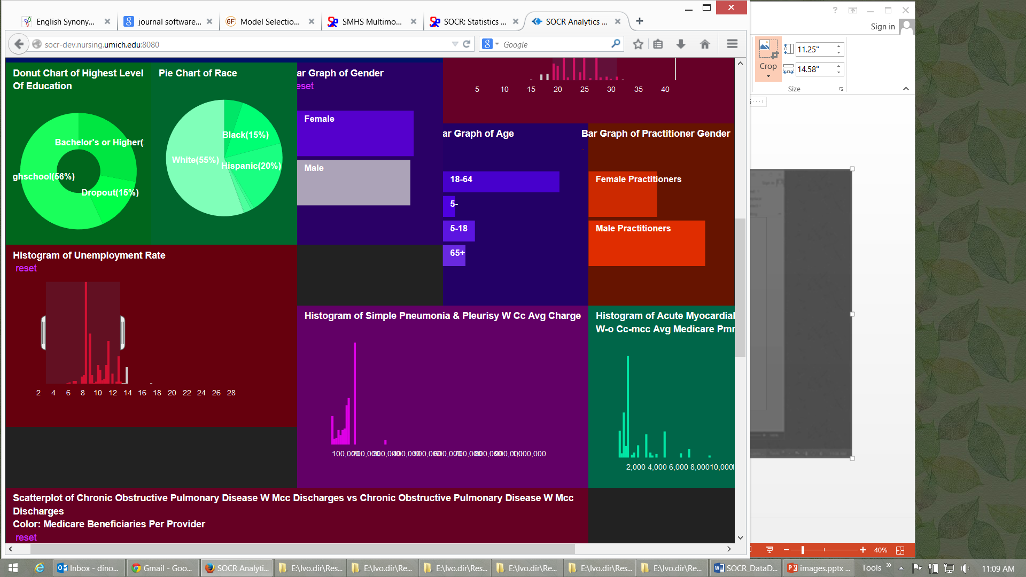
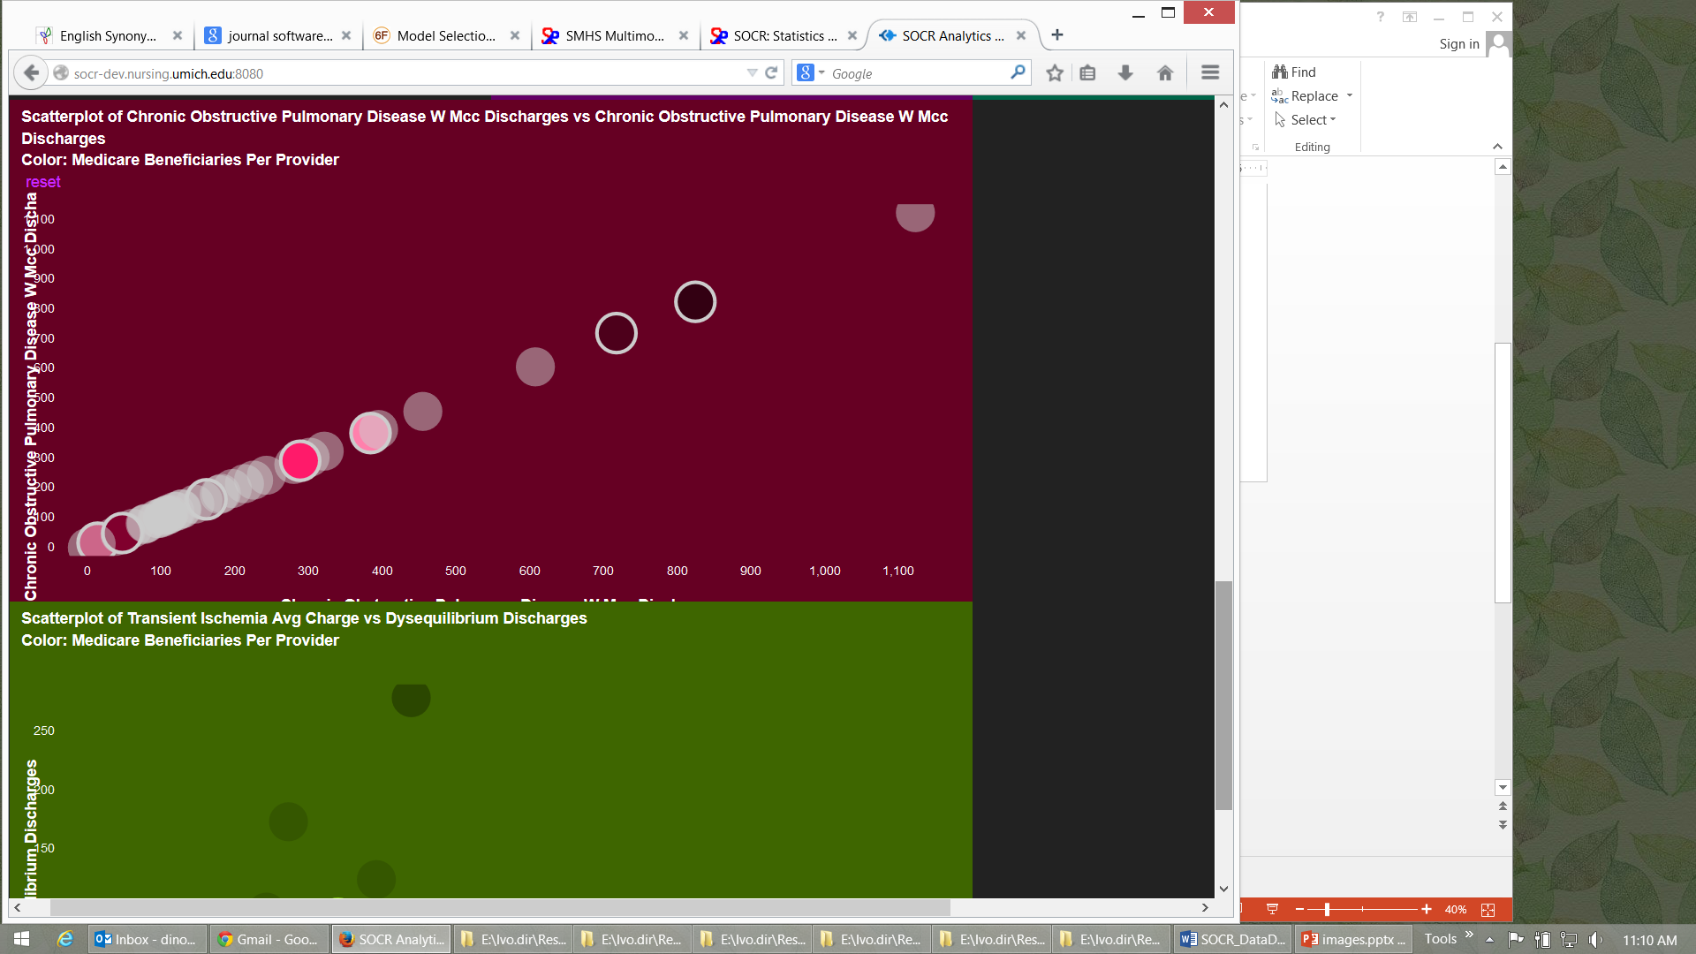
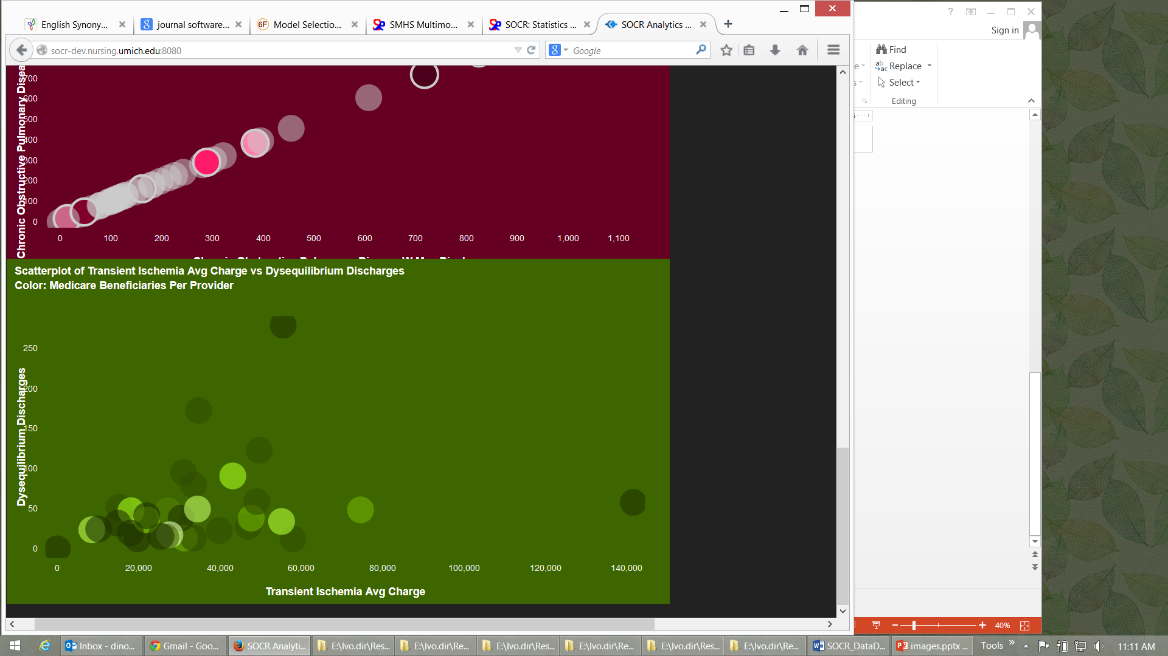
SOCR Big Data Dashboard
http://socr.umich.edu/HTML5/Dashboard
Web-service combining and integrating multi-source socioeconomic and medical datasets
Big data analytic processing
Interface for exploratory navigation, manipulation and visualization
Adding/removing of visual queries and interactive exploration of multivariate associations
Powerful HTML5 technology enabling mobile on-demand computing
Husain, et al., 2015, J Big Data

Slide 120
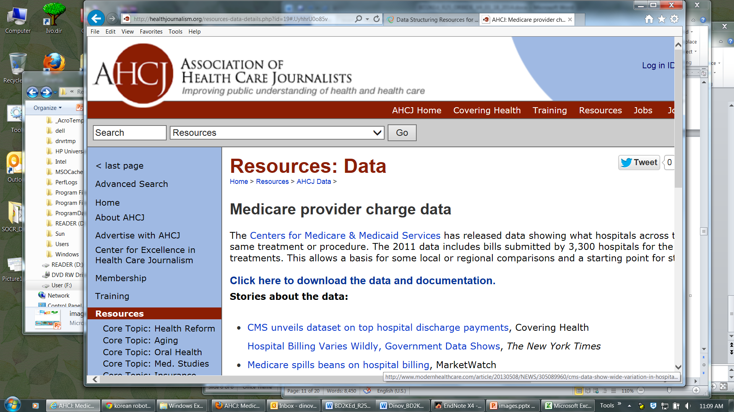
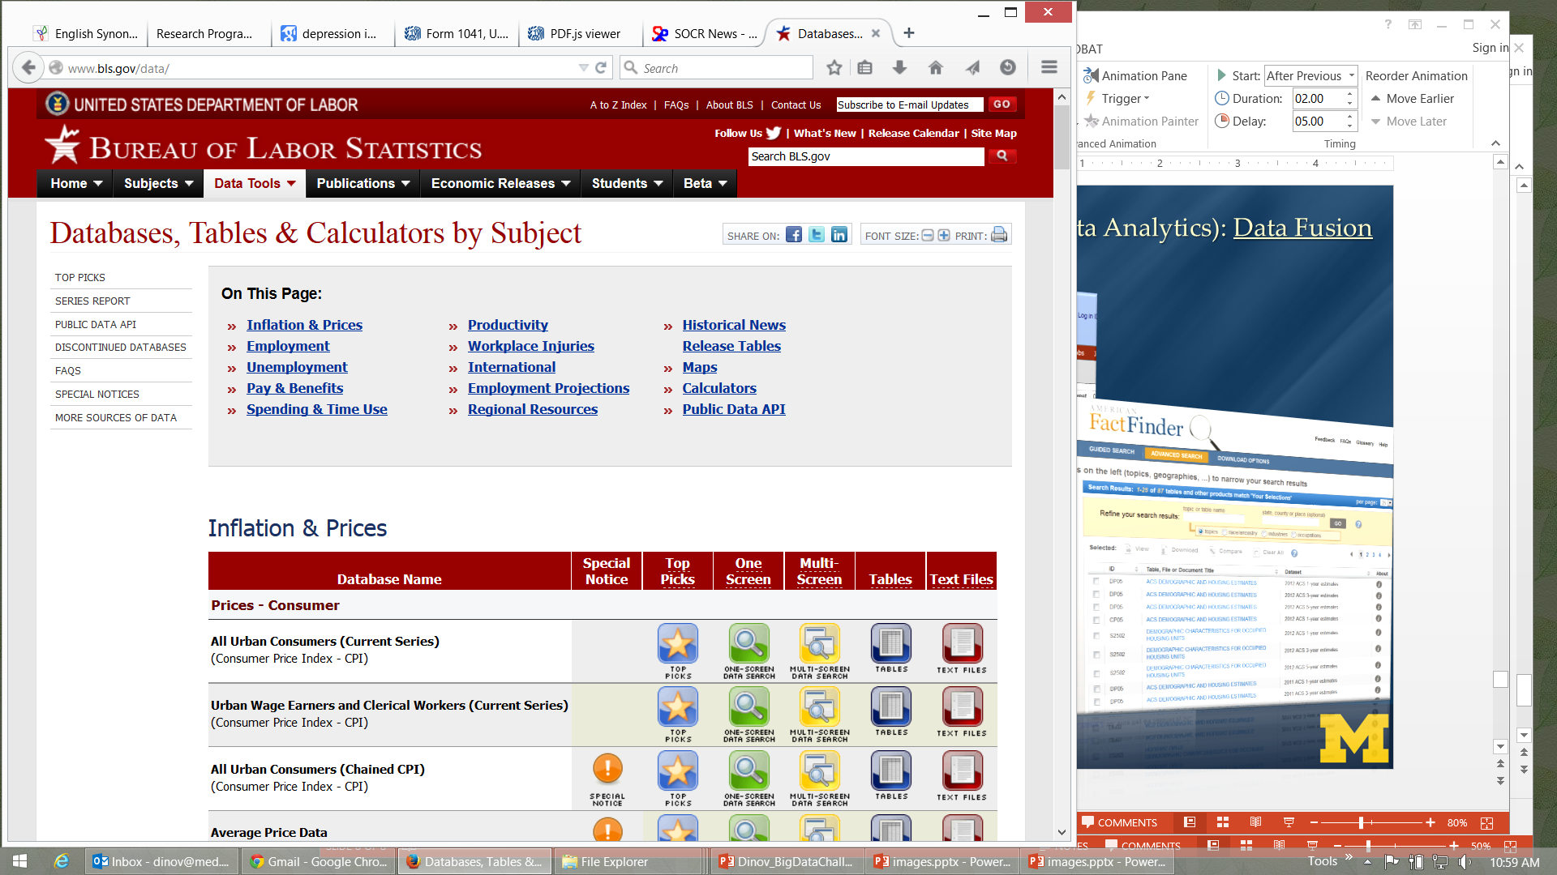
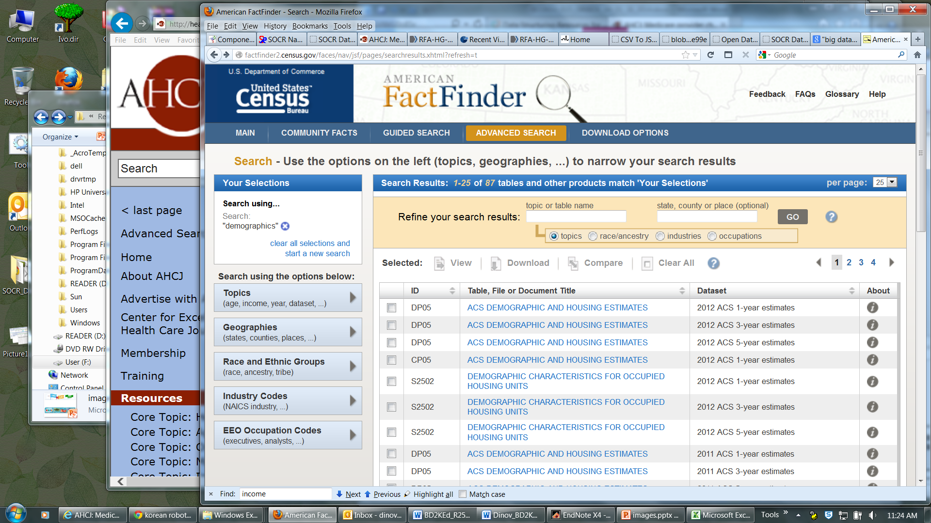
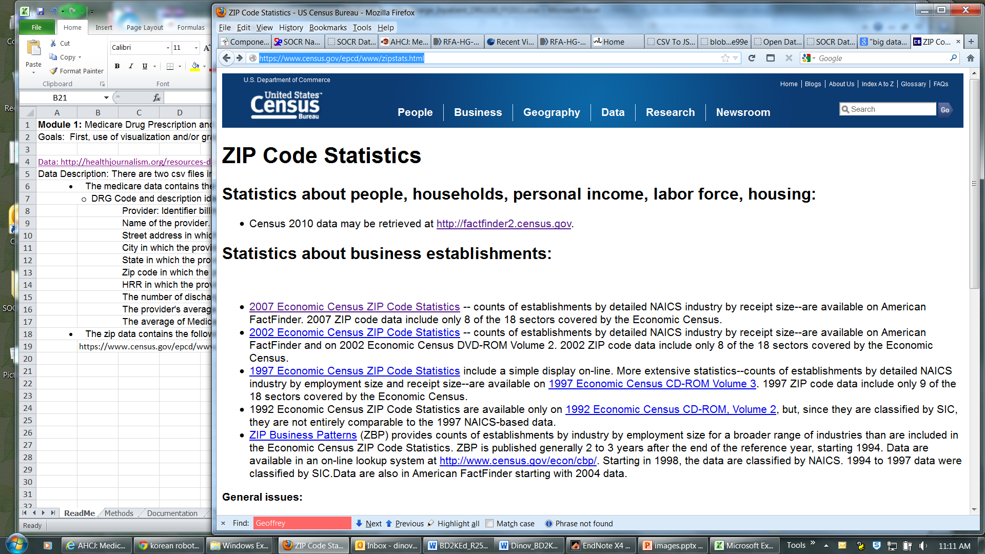
SOCR Dashboard (Exploratory Big Data Analytics): Data Fusion
http://socr.umich.edu/HTML5/Dashboard
Notes:
Imaging Pheno/Genotype Associations: Data

Slide 121
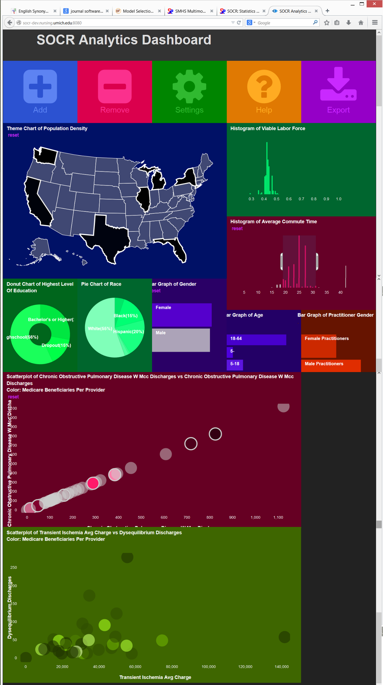
SOCR Dashboard (Exploratory Big Data Analytics): Associations
Notes:
Depression Center collaboration with Melvin McInnis and Anh Truong

Slide 122
Compressive Big Data Analytics (CBDA)
The foundation for Compressive Big Data Analytics (CBDA) involves
Iteratively generating random (sub)samples from the Big Data collection.
Then, using classical techniques to obtain model-based or non-parametric inference based on the sample.
Next, compute likelihood estimates (e.g., probability values quantifying effects, relations, sizes)
Repeat – the process continues iteratively.
Repeating the (re)sampling and inference steps many times (with or without using the results of previous iterations as priors for subsequent steps).
Dinov, J Med Stat & Info, 2016

Slide 123
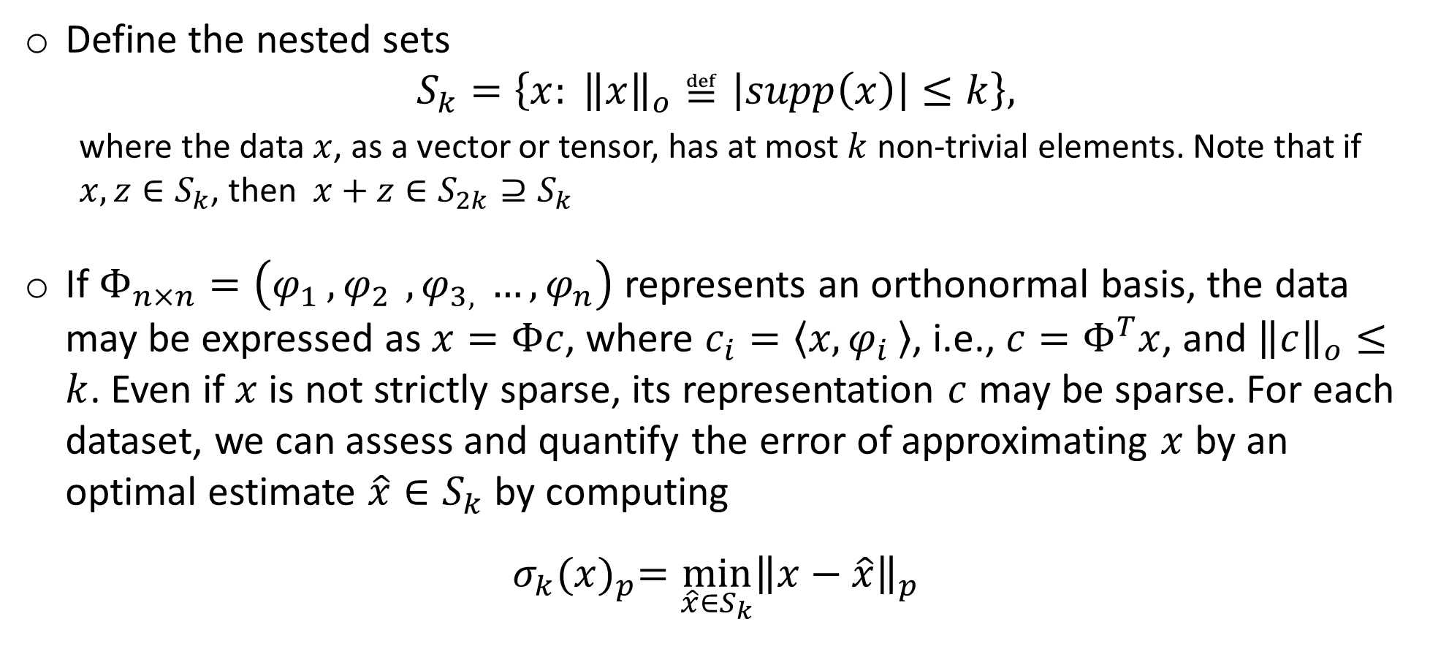
Big Data Analytics – Compressive Sensing
Define the nested sets
$$S_{k}=\left\{x: {\left\|x\right\|}_{o}≝\left|supp\left(x\right)\right|≤k\right\},$$
where the data $x$, as a vector or tensor, has at most $k$ non-trivial elements. Note that if $x,z∈S_{k}$, then $x+z∈S_{2k}⊇S_{k}$
If $Φ_{n×n}=\left(φ_{1 }{, φ}_{2 }, φ_{3, }…, φ_{n}\right)$ represents an orthonormal basis, the data may be expressed as $x=Φc$, where $c_{i}=〈x,φ_{i }〉$, i.e., $c=Φ^{T}x$, and ${\left\|c\right\|}_{o}≤k$. Even if $x$ is not strictly sparse, its representation $c$ may be sparse. For each dataset, we can assess and quantify the error of approximating $x$ by an optimal estimate $\hat{x}{∈S}_{k}$ by computing
$$σ_{k}{(x)}_{p}=\min_{\hat{x}{∈S}_{k}}{{\left\|x−\hat{x}\right\|}_{p}}$$

Slide 124
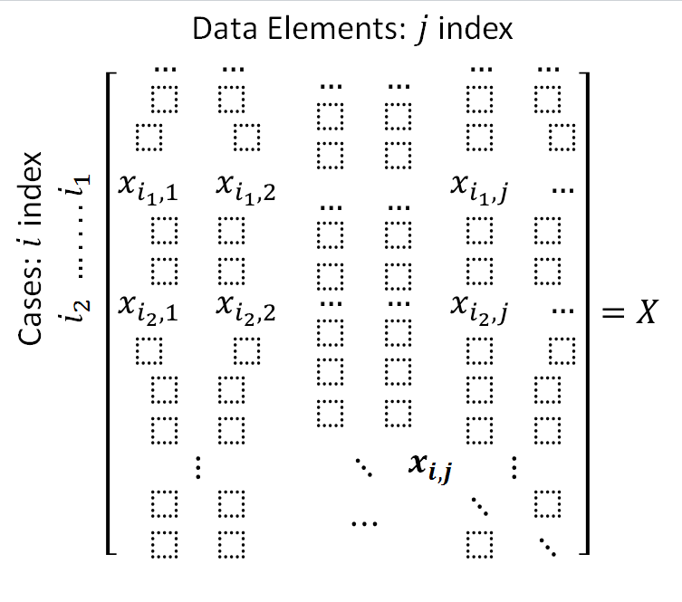
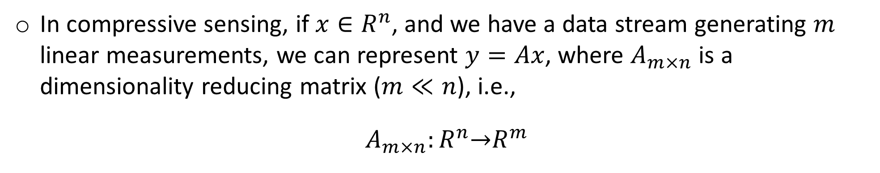
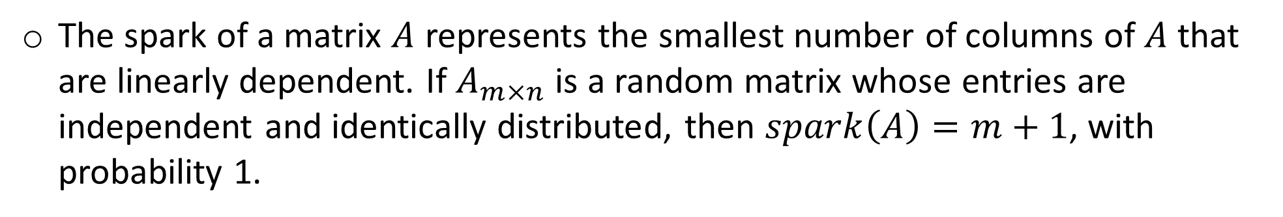
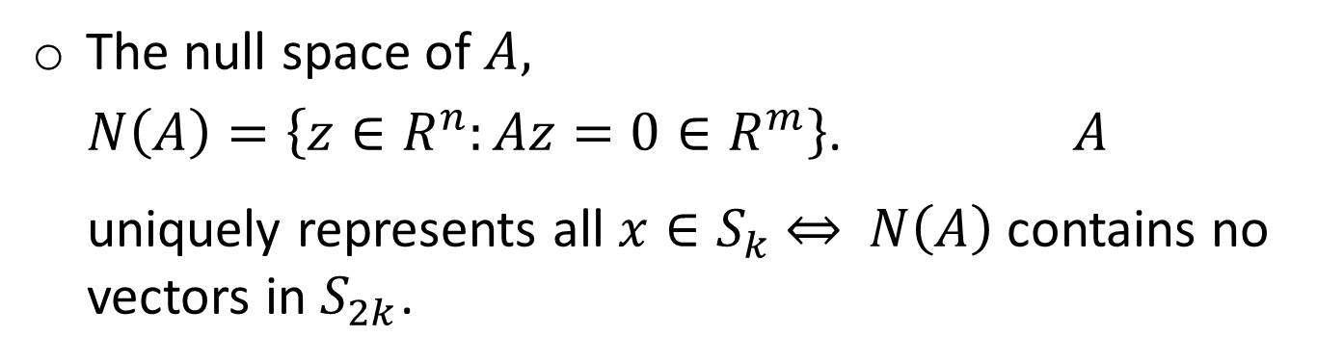
Big Data Analytics – Compressive Sensing
In compressive sensing, if $x∈R^{n}$, and we have a data stream generating $m$ linear measurements, we can represent $y=Ax$, where $A_{m×n}$ is a dimensionality reducing matrix ($m≪n$), i.e.,
$A_{m×n}:R^{n}\underset{→}{}R^{m}$
The null space of $A,$
$N\left(A\right)=\left\{z∈R^{n}:Az=0∈R^{m}\right\}$. $A$ uniquely represents all $x∈S_{k} \underset{⇔}{}$ $N\left(A\right)$ contains no vectors in $S_{2k}$.
The spark of a matrix $A$ represents the smallest number of columns of $A$ that are linearly dependent. If $A_{m×n}$ is a random matrix whose entries are independent and identically distributed, then $spark\left(A\right)=m+1$, with probability 1.

Slide 125

Big Data Analytics – Compressive Sensing
If the entries of $A$ are chosen according to a sub-Gaussian distribution, then with high probability, for each $k$, there exists $δ_{2k}∈\left(0,1\right)$ such that
$(1−δ_{2k}){\left\|x\right\|}_{2}^{2}≤{\left\|Ax\right\|}_{2}^{2}≤(1+δ_{2k}){\left\|x\right\|}_{2}^{2}$ (1)
for all $x∈S_{2k}$ (RIP=Restricted isometry property)
When we know that the original signal is sparse, to reconstruct $x$ given the observed measurements $y$, we can solve the optimization problem:
$$\hat{x}=\arg{\min_{z:Az=y}{{\left\|z\right\|}_{0}}}$$
Notes:
Restricted Isometry Property (RIP)

Slide 126

Big Data Analytics – Compressive Sensing
Linear programming may be used to solve the optimization problem if we replace the zero-norm by its more tractable convex approximation, the $l_{1}$-norm, $\hat{x}=\arg{\min_{z:Az=y}{{\left\|z\right\|}_{1}}}$
Given that $A_{m×n}$ has the above property and $δ_{2k}<\sqrt{2}−1$, if we observe $y = Ax$, then the solution $\hat{x}$ satisfies
${\left\|\hat{x}−x\right\|}_{2}≤C_{0}\frac{σ_{k}{\left(x\right)}_{1}}{\sqrt{k}}$
Thus, in compressive sensing applications, if $x∈S_{k}$ and $A$satisfies the RIP, condition (1), we can recover any $k$-sparse signal $x$ exactly (as $σ_{k}{\left(x\right)}_{1}=0$) using only $O\left(k\log{(n/k)}\right)$ observations, since $m = O\left(\frac{k\log\left(n/k\right)}{δ_{2k}^{2}}\right)$
Finally, if $A_{m×n}$ is random (e.g., chosen according to a Gaussian distribution) and $Φ_{n×n}$ is an orthonormal basis, then $A_{m×n}×Φ_{n×n}$ will also have a Gaussian distribution, and if $m$ is large, $A^{′}=A×Φ$ will also satisfy the RIP condition (1) with high probability.

Slide 127








Big Data Analytics – Compressive Sensing
$$Z_{N×1}$$
$$D_{N×M}$$
$$S_{M×T}$$
$$X_{T×1}$$
=
×
×
Obs Proxy Prism (dim reducing matrix) Orthonormal basis Nat Process

Slide 128
Compressive Big Data Analytics (CBDA)
The foundation for Compressive Big Data Analytics (CBDA) involves
Iteratively generating random (sub)samples from the Big Data collection.
Then, using classical techniques to obtain model-based or non-parametric inference based on the sample.
Next, compute likelihood estimates (e.g., probability values quantifying effects, relations, sizes)
Repeat – the process continues iteratively.
Repeating the (re)sampling and inference steps many times (with or without using the results of previous iterations as priors for subsequent steps).
Dinov, J Med Stat & Info, 2016

Slide 129
Compressive Big Data Analytics (CBDA)
Bootstrapping techniques may be employed to quantify joint probabilities, estimate likelihoods, predict associations, identify trends, forecast future outcomes, or assess accuracy of findings.
The goals of compressive sensing and compressive big data analytics are different.
CS aims to obtain a stochastic estimate of a complete dataset using sparsely sampled incomplete observations.
CBDA attempts to obtain a quantitative joint inference characterizing likelihoods, tendencies, prognoses, or relationships.
However, a common objective of both problem formulations is the optimality (e.g., reliability, consistency) of their corresponding estimates.

Slide 130

Compressive Big Data Analytics (CBDA)
Suppose we represent (observed) Big Data as a large matrix ${Y∈R}^{n×t}$, where $n$= sample size (instances) and $t$ = elements (e.g., time, space, measurements, etc.)
To formulate the problem in an analytical framework, let’s assume $L∈R^{n×t}$is a low rank matrix representing the mean or background data features, $D∈R^{n×m}$ is a (known or unknown) design or dictionary matrix, $S∈R^{m×t}$ is a sparce parameter matrix with small support ($supp(S)≪m×t$), $E∈R^{n×t}$ denote the model error term, and $Λ_{Ω}\left(.\right)$ be a sampling operator generating incomplete data over the indexing pairs of instances and data elements $Ω⊆\left\{1, 2, …, n\right\}×\left\{1,2,…,t\right\}$
In this generalized model setting, the problem formulation involves estimation of $L, S$(and $D$, if it is unknown), according to this model representation:$Λ_{Ω}\left(Y\right)=Λ_{Ω}\left(L+DS+E\right)$ (2)

Slide 131

Compressive Big Data Analytics (CBDA)
Having quick, reliable and efficient estimates of $L, S$and $D$ would allow us to make inference, compute likelihoods (e.g., p-values), predict trends, forecast outcomes, and adapt the model to obtain revised inference using new data
When $D$ is known, the model in equation (2) is jointly convex for $L$ and $S$, and there exist iterative solvers based on sub-gradient recursion (e.g., alternating direction method of multipliers)
However, in practice, the size of Big Datasets presents significant computational problems, related to slow algorithm convergence, for estimating these components that are critical for the final study inference

Slide 132

Compressive Big Data Analytics (CBDA)
One strategy for tackling this optimization problem is to use a random Gaussian sub-sampling matrix $A_{m×n}$ (much like in the compressive sensing protocol) to reduce the rank of the observed data ($Y_{m×l}$, where $\left(m,l\right)∈Ω$) and then solve the minimization using least squares
This partitioning of the difficult general problem into smaller chunks has several advantages. It reduces the hardware and computational burden, enables algorithmic parallelization of the global solution, and ensures feasibility of the analytical results
Because of the stochastic nature of the index sampling, this approach may have desirable analytical properties like predictable asymptotic behavior, limited error bounds, estimates’ optimality and consistency characteristics

Slide 133


Compressive Big Data Analytics (CBDA)
Data Structure (Representation) Sample Data (Instance)

Slide 134

Compressive Big Data Analytics (CBDA)
One can design an algorithm that searches and keeps only the most informative data elements by requiring that the derived estimates represent optimal approximations to $y$within a specific sampling index subspace $\left\{\left(m,l\right)\right\}⊆Ω$
We want to investigate if CBDA inference estimates can be shown to obey error bounds similar to the upper bound results of point imbedding’s in high-dimensions (e.g., Johnson-Lindenstrauss lemma) or the restricted isometry property

Slide 135

Compressive Big Data Analytics (CBDA)
The Johnson-Lindenstrauss lemma guarantees that for any $0<ε<1$, a set of points ${\left\{P_{k}\right\}}_{1}^{K}∈R^{n}$ can be linearly embedded $\left(Ψ:R^{n}\underset{→}{ }R^{n^{′}}\right)$ into ${{\left\{{Ψ\left(P_{k}\right)=P}_{k}′\right\}}_{1}^{K}∈R}^{n^{′}}$, for $∀$ $n^{′}≥4\left(\frac{ln⁡(K)}{\frac{ε^{2}}{2} − \frac{ε^{3}}{3}}\right)$, almost preserving their pairwise distances, i.e., $(1−ε){\left\|P_{i}−P_{j}\right\|}_{2}^{2}≤{\left\|P_{i}′−P_{j}′\right\|}_{2}^{2}{≤(1+ε)\left\|P_{i}−P_{j}\right\|}_{2}^{2}$
The restricted isometry property ensures that if $δ_{2k}<\sqrt{2}−1$ and the estimate $\hat{x}=\arg{\min_{z:Az=y}{{\left\|z\right\|}_{1}}}$, where $A_{m×n}$ satisfies property (1), then the data reconstruction is reasonable, i.e., ${\left\|\hat{x}−x\right\|}_{2}≤C_{0}\frac{σ_{k}{\left(x\right)}_{1}}{\sqrt{k}}$
Can we develop iterative space-partitioning CBDA algorithms that either converge to a fix point or generate estimates that are close to their corresponding inferential parameters?

Slide 136





Acknowledgments
http://SOCR.umich.edu
Funding
NIH: P50 NS091856, P30 DK089503, P30AG053760, P20 NR015331, U54 EB020406
NSF: 1636840, 1416953, 0716055, 1023115
Collaborators
SOCR: Alexandr Kalinin, Selvam Palanimalai, Syed Husain, Matt Leventhal, Ashwini Khare, Rami Elkest, Abhishek Chowdhury, Patrick Tan, Gary Chan, Andy Foglia, Pratyush Pati, Brian Zhang, Juana Sanchez, Dennis Pearl, Kyle Siegrist, Rob Gould, Jingshu Xu, Nellie Ponarul, Ming Tang, Asiyah Lin, Nicolas Christou
LONI/INI: Arthur Toga, Roger Woods, Jack Van Horn, Zhuowen Tu, Yonggang Shi, David Shattuck, Elizabeth Sowell, Katherine Narr, Anand Joshi, Shantanu Joshi, Paul Thompson, Luminita Vese, Stan Osher, Stefano Soatto, Seok Moon, Junning Li, Young Sung, Fabio Macciardi, Federica Torri, Carl Kesselman,
UMich AD/PD Centers: Cathie Spino, Brian, Athey, Hank Paulson, Ben Hampstead, Bill Dauer

Slide 138
11:00-11:10 | Break
11:10-12:10 | Lightning Talks | 3-5 min Rapid-Fire talks from the Midwest Big Data Community
12:10-1:10 | Lunch Break

Slide 140
1:10-2:40 | Unconference Breakout Sessions (3 consecutive slots of 30-min each). Participants are encouraged to lead breakouts and mix with others | Informal self-organized sessions (30-minutes each), round-robin rotations: Brain structure, Function, Diffusion, Physiology; File Formats; Pipeline workflow Environments; Cloud Services: JIRA, GitHub, Trello, AWS, MapReduce, Hadoop; Driving Biomedical/Healthcare Challenges, etc.
2:40-2:50 | Break
2:50-3:30 | Breakout sessions reports | Analytics Pipelines Tools/Services
 |  | Challenges
 |  | Known Solutions
 |  | Predictive analytics - methods, tools, protocols, workflows
 |  | Provenance (data, protocols, results, reproducibility or research findings)
 |  | Computational Neuroscience Methods
 |  | Case-studies, data archives, Cloud Services

Slide 142
3:30-4:00 | Live Demos Try-It-Now | Applications (brain mapping, imaging-genetics neurodegeneration)
4:00 PM | Conclusions | Workshop Evaluation (http://www.neurosciencenetwork.org/ACNN_Workshop_2016.html). Collaborations, joint papers, extramural grant opportunities, Shareable resources, Available Webapps, APIs, workflows

Slide 144
Post-conference Evaluation
Please complete the anonymous web-based workshop evaluation form. The aggregate results of this evaluation will be used to improve, enhance and expand future ACNN training events, activities and bootcamps. The sponsors will also be informed of the summative workshop evaluation results
http://goo.gl/forms/qSI6PGiN4PfTs6Fg1

Slide 145
Workshop Sponsors
The National Science Foundation
http://www.nsf.gov
Midwest Big Data Hub
http://MidwestBigDataHub.org
OSU Network Based Computing
http://nowlab.cse.ohio-state.edu
 | High-performance Big Data (HiBD) Network-Based Computing Laboratory
The Michigan Institute for Data Science (MIDAS)
http://midas.umich.edu
The Indiana Imaging Research Facility (IRF)
https://www.indiana.edu/~irf/home
Imaging Research Facility
Indiana University Bloomington
CWRU Biomedical and Healthcare Informatics
https://goo.gl/l19s07
Michigan Nutrition Obesity Research Center
(MNORC) http://mmoc.med.umich.edu

